Slide 1
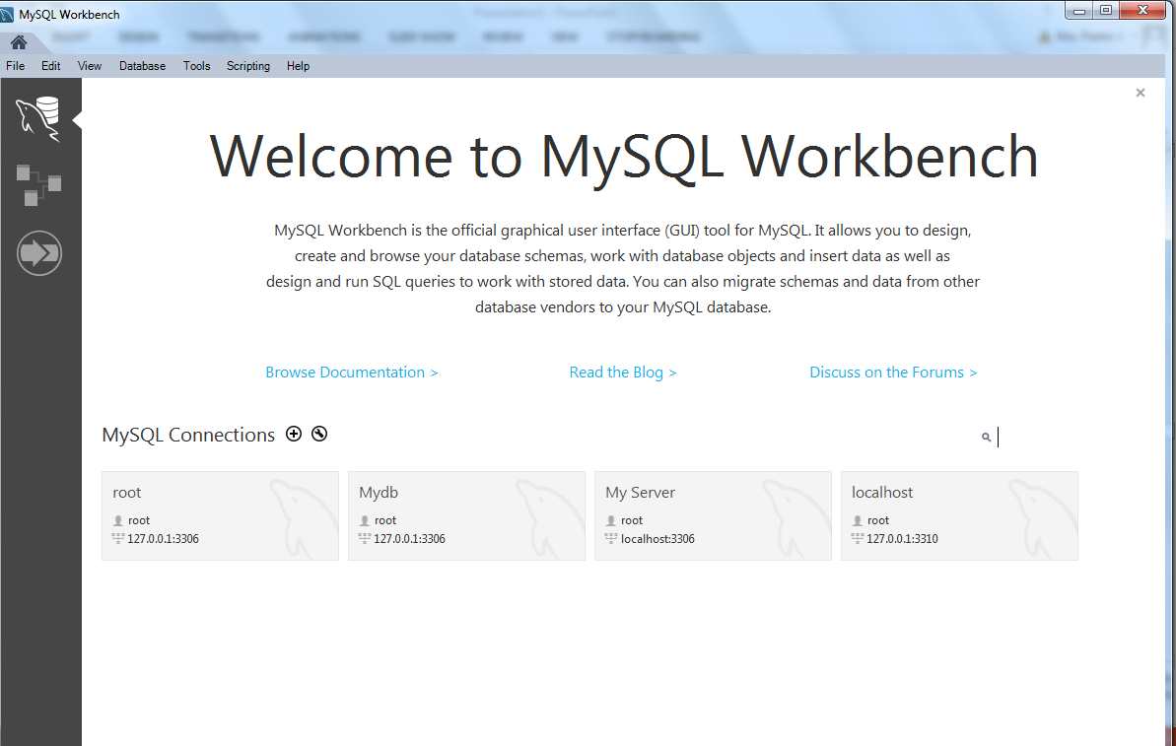
First, open your Workbench

Slide 2
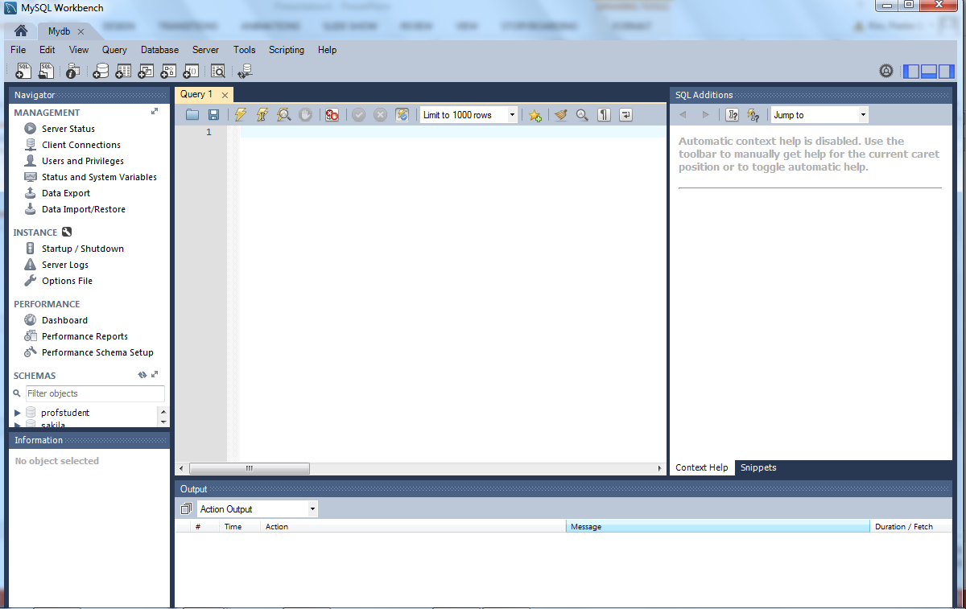
We are going to enter our SQL commands here

Slide 3
We are going to create our Database (ProfSudent) and our Table Profs

Slide 4
Let’s copy these in groups
Let’s copy the commands to create and use our database

Slide 5
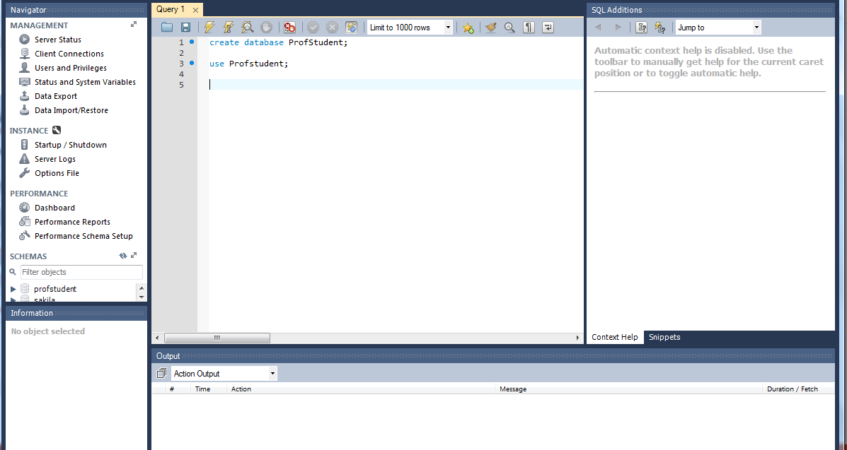
Paste them into the Script/Query editor

Slide 6
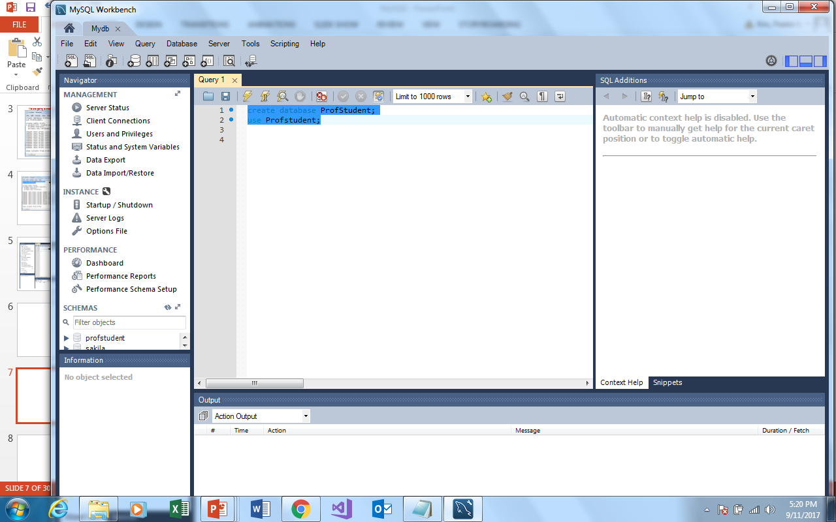
We can execute these commands by hi-lighting them
And then clicking the run (thunder bolt)

Slide 7
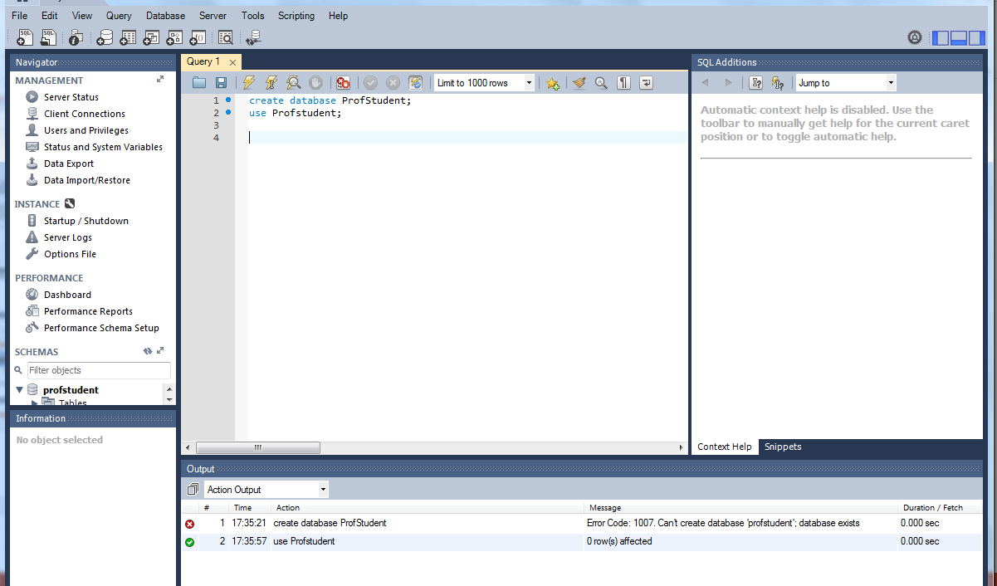
I’ve already created the Database
But I can issue the command to use it

Slide 8
We can follow the same procedures to create our table Profs
Copy

Slide 9
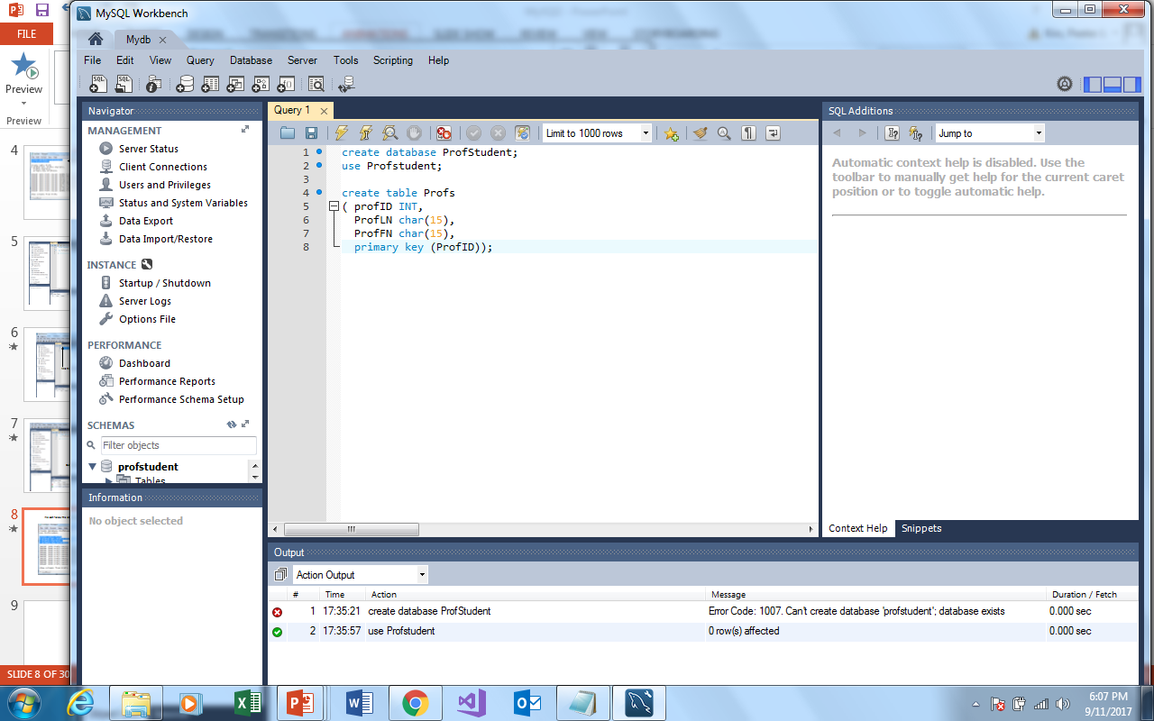
And Paste

Slide 10
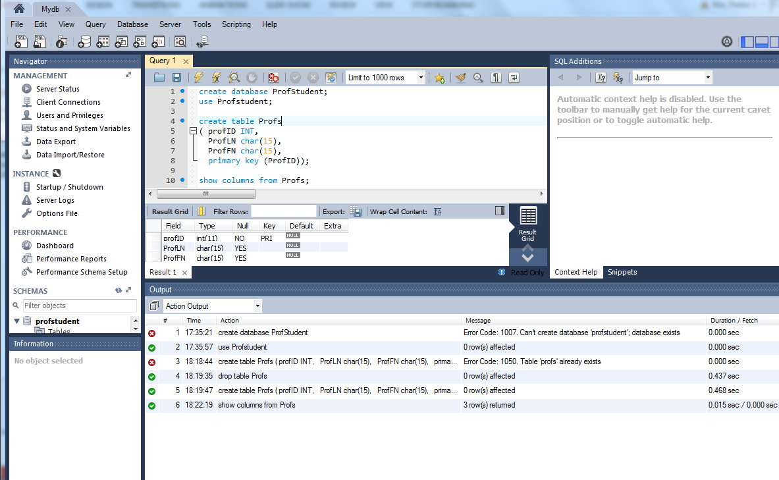

Slide 11
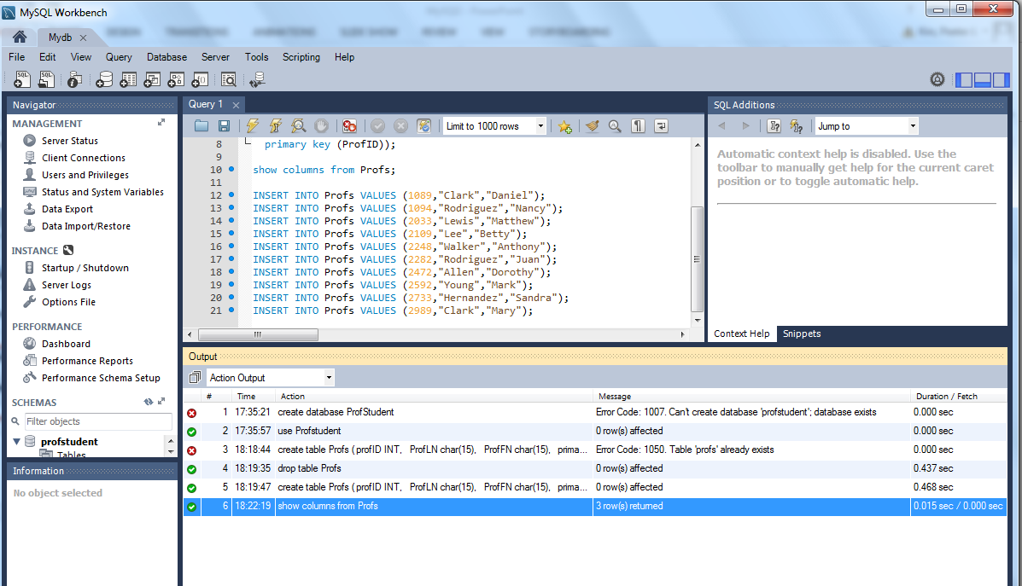
I copied and Pasted the data into workbench

Slide 12
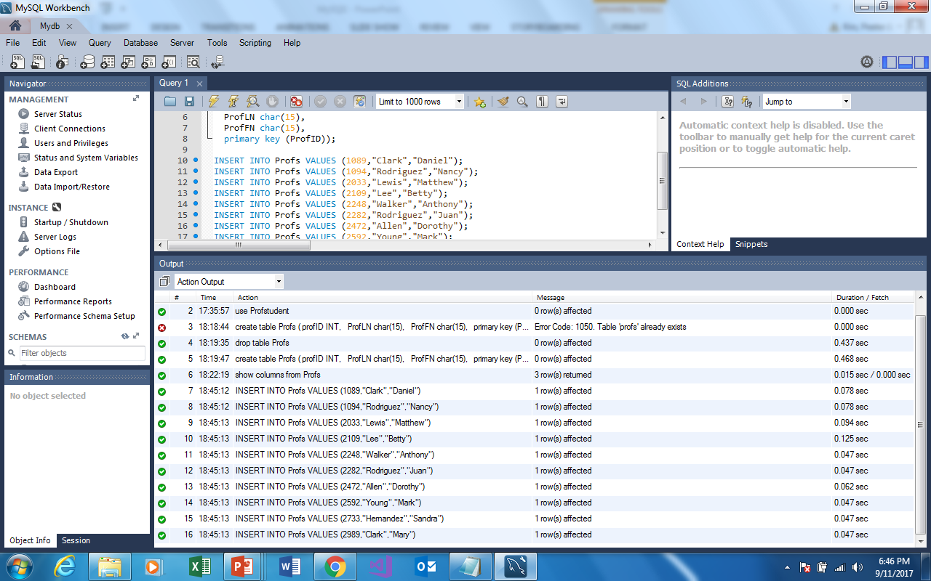

Slide 13
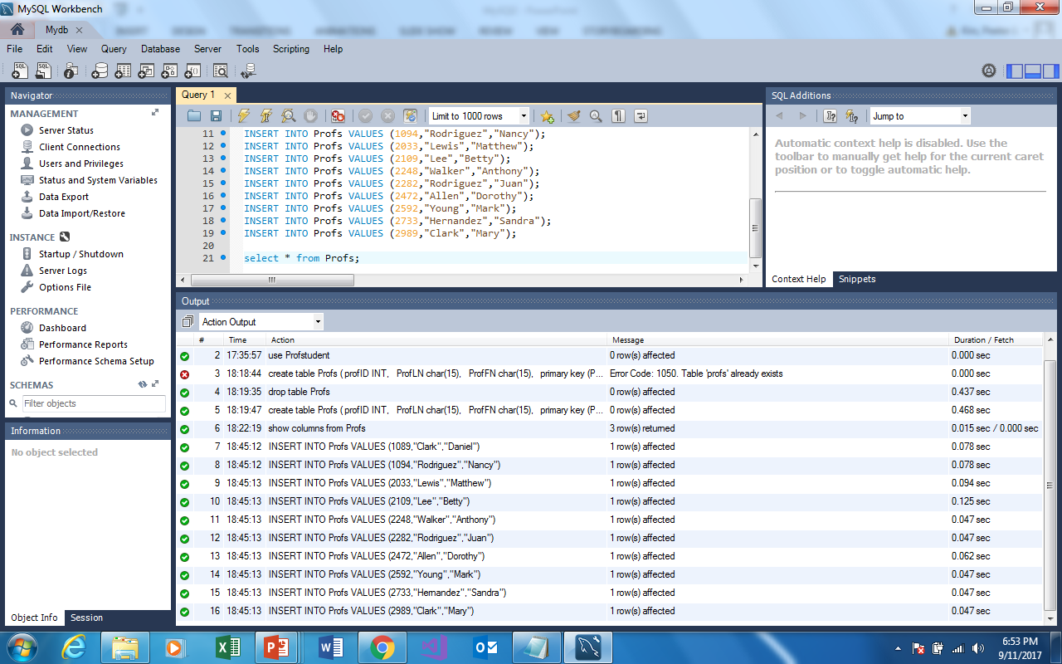

Slide 14
I have added two more lines
The first line produces this output

Slide 15
The second line produces this output

Slide 16
Create The Student Table and populate it just as we did with the Profs table (I’ll wait)

Slide 17
Note the two lines (again)
The first line produces this output

Slide 18
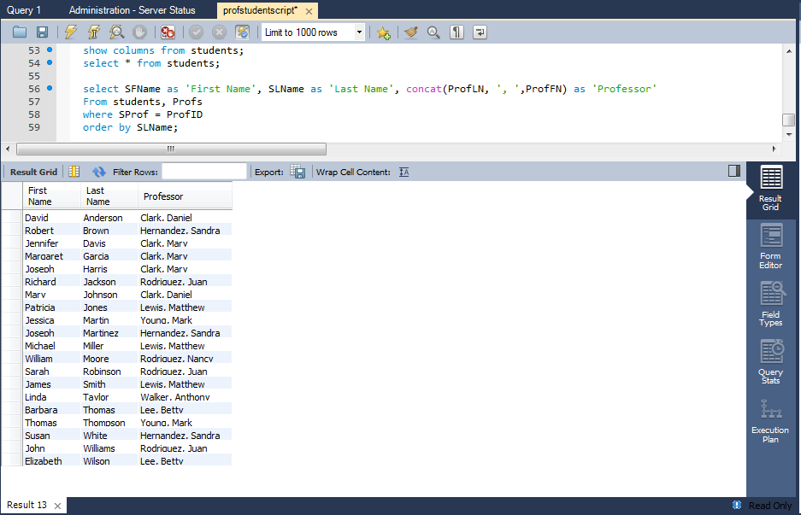
The final query produces this output

Slide 19
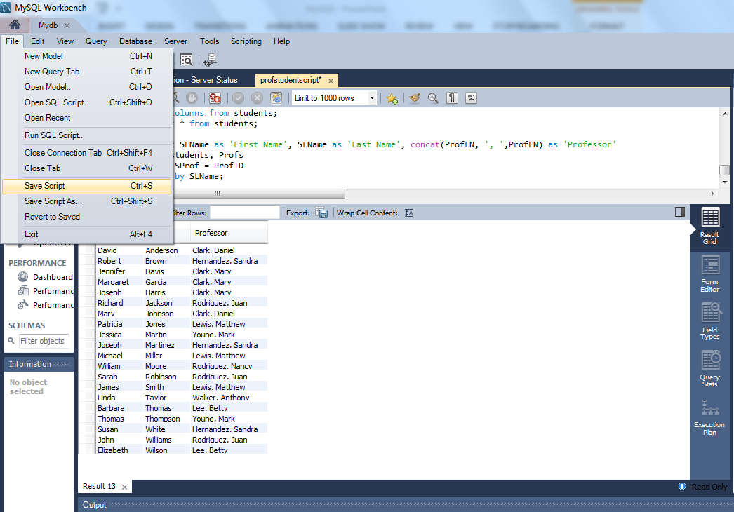
As a precaution, save your scripts as often as possible

Slide 20
