Slide 1
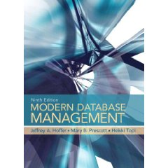
Chapter 1: The Database Environment
Chapter 1
The Database Environment

Slide 2
Chapter 1: The Database Environment
Data, Data Everywhere *
The Sloan Digital Sky Survey started in 2000. In its first few weeks it collected more data than had been amassed the entire history of astronomy
By 2010, it had collected 140 terabytes of data
Its replacement, scheduled for 2016, will collect that amount of data every 5 days
In 2010, Walmart processed 1M customer transactions every hour
This equates to 2.5 petabytes, the equivalent of 167 times the books in the American Library of Congress
Facebook houses more than 40 billion photos
* Excerpted from a Feb. 27th, 2010, Economist article

Slide 3
Chapter 1: The Database Environment
Data, Data Everywhere *
Decoding the human genome involves 3 billion base pairs.
The first time it was attempted, it took 10 years
It can now be accomplished in 1 week.
It is estimated that within the next few years, the amount of global data created will approach 2,000 Exabytes per year
(1 Exabyte = 1,000 Petabytes)
Problem: It is estimated that the total amount of storage available will be approximately 100 Exabytes
* Excerpted from a Feb. 27th, 2010, Economist article

Slide 4
Chapter 1: The Database Environment
Data, Data Everywhere *
Kilobyte = 2¹⁰ bytes 1,024 bytes
One page of typed text typically requires 2K
Megabyte = 2²⁰ bytes 1,048,576 bytes
Storing the complete works of Shakespeare requires 5MB
Gigabyte = 2³⁰ bytes 1,073,741,824 bytes
A 2-hour film requires 1-2 GB
Terabyte = 2⁴⁰ bytes 1,099,511,627,776 bytes
All of the books in the Library of Congress requires 15 TB
Petabyte = 2⁵⁰ bytes 1,125,899,906,842,624 bytes
Google processes about 1 PB every hour
Exabyte = 2⁶⁰ bytes 1,152,921,504,606,846,976 bytes
Equivalent to 10 billion copies of the economist
Zettabyte = 2⁷⁰ bytes 1,180,591,620,717,411,303,424 bytes
The total amt. of information in existence is estimated at 1.2 ZB
Yottabyte = 2⁸⁰ bytes 1,208,925,819,614,629,174,706,176 bytes
* Excerpted from a Feb. 27th, 2010, Economist article

Slide 5
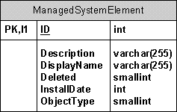
Chapter 1: The Database Environment
What is a Database??
A large, logical, integrated collection of Data and Metadata
Metadata??
Data about data.
It describes how and when and by whom a particular set of data was collected, and how the data is formatted. Metadata is essential for understanding information stored in data warehouses.
Data only are useful when placed in some context
(Shouldn’t it be: ‘Data only is useful when placed in some context’???)

Slide 6
Chapter 1: The Database Environment
What is a Database??
A large, logical, integrated collection of Data and Metadata
Metadata??
Metadata for a class roster
Data Item
Name | Type | Length | Min | Max | Description | Source
Course | Alphanum. | 30 |  |  | Course Name/ID | Academic Unit
Section | Integer | 1 | 1 | 9 | Section Number | Registrar
Semester | Alphanum | 10 |  |  | Semester/Year | Registrar
Name | Alphanum | 30 |  |  | Student Name | Student
ID | Integer | 9 |  |  | Student No. | Student
Major | Alphanum | 4 |  |  | Student Major | Student
GPA | Decimal | 3 | 0.0 | 4.0 | Grade pt. Ave | Academic unit

Slide 7

Chapter 1: The Database Environment
Metadata??
This term has been given a lot of attention lately (and not defined well)
Structural Metadata
Refers to the design and specification of data structures and is more properly called "data about the containers of data” (Wiki)
Descriptive Metadata or Metacontent.
Refers to individual instances of application data, the data content. In this case, a useful description would be "data about data content" or "content about content"
There is no clear line between content and meta-content. We can always view any piece of meta-content as content. The best example of this blurring occurs in the case of book reviews. A book review is a piece of meta information about a piece of content - the book being reviewed. (http://downlode.org/Etext/MCF/towards_a_theory_of_metacontent.html)

Slide 8

Chapter 1: The Database Environment
Why is Structural Metadata so Important??
Let’s quickly overview how a computer operates
A computer is really nothing more than a grouping of switches (really!!)
This single switch is a Binary Digit (BIT)
So??
This grouping of switches is a Byte (8-bits)
A switch, it can only be On or Off (A Binary Situation)
We store all of the numbers in the computer in binary (0 = off; 1 = 0)

Slide 9
Chapter 1: The Database Environment
Why is Structural Metadata so Important??
Let’s quickly overview how a computer operates
Does that mean that if we see the sequence:
Off
On
Off
Off
Off
Off
Off
On
We are looking at the integer 65?
0
1
0
0
0
0
0
1
-- Maybe --
As we can see from the table the binary number 01000001 is the decimal number 65
However, the character ‘A’ is also stored as 65 (ASCII)
Consider the binary Number 10000001
It might be the decimal number 129 (if stored as an unsigned integer)
OR
It might be the decimal number -127 (if stored as an signed integer)
-- It all depends on what it is declared to be (Metadata) --
Consider the Real Number -42.0225
Sign
It needs to be rewritten as: - .420225 E2
And stored (in binary on 32-bits) as:
Sign
Exponent
Mantissa
Mantissa
Exponent
1
0
0
0
0
0
1
0
0
0
0
0
0
0
0
0
0
1
1
0
1
0
0
1
1
0
0
0
0
0
0
1
* This is not the true storage pattern

Slide 10
Chapter 1: The Database Environment
Why is Structural Metadata so Important??
Let’s quickly overview how a computer operates
Other metadata we need to know Includes:
What address in RAM the data is stored at
What address in External Storage the data is stored at
Who has privileges to access the data and at what level
As well as other information

Slide 11
Chapter 1: The Database Environment
How do we create metadata in SQL??
In a number of ways, but initially when we create a table
CREATE TABLE student
( stid Integer,
lastname CHAR(30) NOT NULL,
firstname CHAR(15),
street CHAR(20),
city CHAR(2),
state CHAR(2) DEFAULT ‘TX’,
zip CHAR(5),
dob DATE,
gpa DECIMAL(5,3),
PRIMARY KEY (stid),
CHECK (gpa BETWEEN 0.000 AND 4.00));
Basic data types in SQL
Storage requirements

Slide 12
Chapter 1: The Database Environment
Traditional Concepts of Data
Data referred to facts concerning objects and events that could be recorded and stored on computer media
e.g.: A salesperson’s database would contain facts such as a customer’s name, address, and telephone number
(Structured Data)
What has changed??
Databases now also include such objects as photos, audio and video clips, and hyperlinks.
(Unstructured Data)

Slide 13
Computer and Information Technology Occupations
Occupation | Job Summary | Entry Level Education | 2010 Median Pay
Computer and Information Research Scientists | Computer and information research scientists invent and design new technology and find new uses for existing technology. They study and solve complex problems in computing for business, science, medicine, and other uses. | Doctoral or professional degree | $100,660
Computer Programmers | Computer programmers write code to create software programs. They turn the program designs created by software developers and engineers into instructions that a computer can follow. | Bachelor’s degree | $71,380
Computer Support Specialists | Computer support specialists provide help and advice to people and organizations using computer software or equipment. Some, called technical support specialists, support information technology (IT) employees within their organization. Others, called help-desk technicians, assist non-IT users who are having computer problems. | Some college, no degree | $46,260
Computer Systems Analysts | Computer systems analysts study an organization's current computer systems and procedures and make recommendations to management to help the organization operate more efficiently and effectively. They bring business and information technology (IT) together by understanding the needs and limitations of both. | Bachelor’s degree | $77,740
Database Administrators | Database administrators use software to store and organize data, such as financial information and customer shipping records. They make sure that data are available to users and are secure from unauthorized access. | Bachelor’s degree | $73,490
Information Security Analysts, Web Developers, and Computer Network Architects | Information security analysts, web developers, and computer network architects all use information technology (IT) to advance their organization’s goals. Security analysts ensure a firm’s information stays safe from cyberattacks. Web developers create websites to help firms have a public face. Computer network architects create the internal networks all workers within organizations use. | Bachelor’s degree | $75,660
Network and Computer Systems Administrators | Network and computer systems administrators are responsible for the day-to-day operation of an organization’s computer networks. They organize, install, and support an organization’s computer systems, including local area networks (LANs), wide area networks (WANs), network segments, intranets, and other data communication systems. | Bachelor’s degree | $69,160
Software Developers | Software developers are the creative minds behind computer programs. Some develop the applications that allow people to do specific tasks on a computer or other device. Others develop the underlying systems that run the devices or control networks. | Bachelor’s degree | $90,530
Source: http://www.bls.gov/ooh/computer-and-information-technology/home.htm (US Bureau of Labor Statistics)

Slide 14
Chapter 1: The Database Environment
Aren’t Data and Information the same thing??
While information systems rely on data, they must provide information
What’s the difference???
Data (pl) is a non-random sequence of symbols
Fernandez, Juan A19 1211 83 77 81
Information, while generally based on data, is something that increases our knowledge
Juan Fernandez is an Accounting Major and has a 80.3 average in Principles of Accounting
(Based on analysis of the above data)

Slide 15

Chapter 1: The Database Environment
What is a Database, really??
A way we can model (parts of) the real world (well, Sort-of)
It contains data about entities (i.e., something that we wish to have information about).
Students
Physicians
Patients
Customers
It contains the attributes (characteristics) about the entity that are important
GPA
Specialty
Illness
Balance Due
It shows the relationships between entities (i.e., how the entities interact).
One Physician has many Patients
A Patient has only one Physician

Slide 16
Chapter 1: The Database Environment
• Consider some data the University maintains:
• Name
• Major
• Tuition Paid
• Address
• Courses Taken
• Tuition Owed
• SSN
• Grades Received
• Grants/Scholarships
• All of this data forms an entity class called STUDENT
You, as a student are an entity instance within that class
• All students must share the same attributes
You all have names, addresses, take course and get grades
If you are the only person, or one of a few, who have ESP, that data would not be stored
• All student attributes must vary
Because we are all mammals, that data would not be stored

Slide 17
Chapter 1: The Database Environment
• Some students have additional data stored
If you are an athlete, data such as the sport you play, athletic scholarships you have, and NCAA eligibility are kept
• Further refinements of data kept may be needed
If you are a football player, data such as position played, yards gained, and touchdowns scored might be stored in an entity called FOOTBALL PLAYERS
If you are a basket player, data such as field goals scored, penalty shots taken might be stored in an entity called BASKET PLAYERS
You are an entity with attributes which vary. Within the University, different areas have different interests in you (i.e., the Registrar, the Bursar, etc.). Nonetheless, you are still part of the University as a whole.

Slide 18
Chapter 1: The Database Environment
HOW does this relate to a database?
You are an entity
A record in a table called Student
with attributes
Fields
which vary
e.g., Student GPAs differ
Within the University, different areas, have different interests in you
The registrar, bursar, and athletic depart-ment all keep differ-ent data on you in different Files
Nonetheless, you are still part of the University
Database

Slide 19
Chapter 1: The Database Environment
HOW does this relate to a database?
Hierarchically:
A Database consists of
Files, which contain
• • •
• • • • •
• •
• • •
• •
• • •
• • •
• •
• • • •
• • •
• • • • •
• •
• • •
• •
• • •
• • •
• •
• • • •
• • •
• • • • •
• •
• • •
• •
• • •
• • •
• •
• • • •
• • •
• • • • •
• •
• • •
• •
• • •
• • •
• •
• • • •
Records, which contain
Hernandez, Juan
123456789
72
2.42
Jones, Mary
234567890
102
3.87
Fields, which may consist of a variety of data types
Notice that there should always be a Key (Unique) Field

Slide 20
Chapter 1: The Database Environment
Alternatively (from smallest to largest component):
Character: A single alphabetic, numeric or other symbol
Field: A group of related characters
Entity: A person, place, object or event
Attribute: A characteristic of an entity
Record: A collection of attributes that describe an entity
File: A group of related records
Database: An integrated collection of logically related data elements

Slide 21
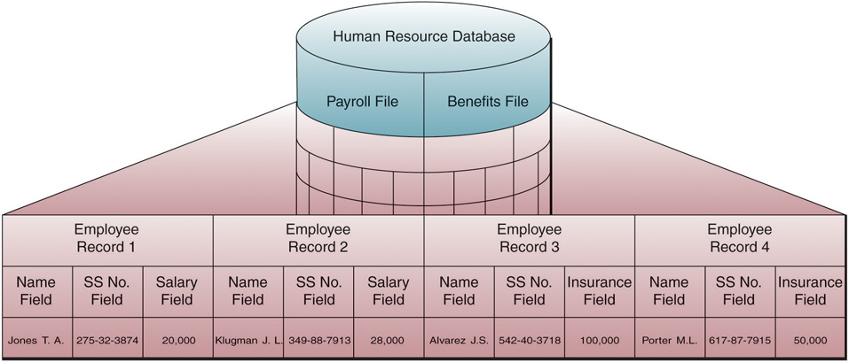
Chapter 1: The Database Environment
Logical Data Elements:

Slide 22
Chapter 1: The Database Environment
Why Databases??
Databases were not always commonplace
• Initially, there were no databases or DataBase Management Systems (DBMS)
• Individual Applications were written to meet specific user needs
(File Processing or Traditional File Processing Systems)
• As business applications became more complex, it became apparent that there were too many problems associated with Traditional Processing Systems

Slide 23

Chapter 1: The Database Environment
What Problems??
• Single Applications
A program was written for (generally) one and only one application
(The user would specify their individual needs)
• Program-Data Dependence
Since each program was written for a specific data set, a change in the data, or data format, required a change in the program which uses the data

Slide 24
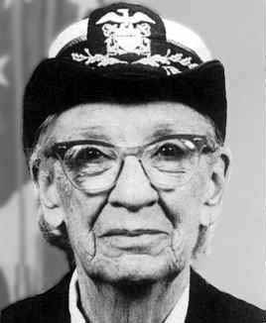
Chapter 1: The Database Environment
What Problems??
Consider the following (Section) of COBOL Code:
FILE-CONTROL .
SELECT INPUTFILE
ASSIGN TO ‘C:\INDATA1.DAT’
ORGANIZATION IS LINE SEQUENTIAL.
FD INPUTFILE
RECORD CONTAINS 73 CHARACTERS.
01 CUSTOMER-RECORD.
05 C-N PIC X(20).
05 C-A PIC X(50).
05 C-B PIC 9(3).
This might be a typical layout used by the Accounting Department to keep track of a customer

Slide 25
Chapter 1: The Database Environment
What Problems??
The Program assumes that there is a data file called ‘INDATA1.DAT’ (on disk drive C:) that is laid out as:
Cols: 1 2 3 4 5 6 7
1234567890123456789012345678901234567890123456789012345678901234567890123
John Smith 123 Main St., Arlington, TX 76005 123
05 C-N PIC X(20).
05 C-A PIC X(50).
05 C-B PIC 9(3).
Any Different Layout and the data would not be read Correctly

Slide 26
Chapter 1: The Database Environment
What Problems??
What Problems??
Assume that the Service Department Also keeps data on the same customer using the following COBOL Code:
FILE-CONTROL .
SELECT INPUTFILE
ASSIGN TO ‘C:\INDATA2.DAT’
ORGANIZATION IS LINE SEQUENTIAL.
FD INPUTFILE
RECORD CONTAINS 56 CHARACTERS.
01 CUSTOMER-RECORD.
05 CUST-LNAME PIC X(15).
05 CUST-FNAME PIC X(8).
05 CUST-STREET PIC X(14).
05 CUST-CITY PIC X(10).
05 CUST-STATE PIC X(2).
05 CUST-ZIP PIC X(5).
05 CUST-PRODUCT PIC X(10).
Almost the same data as kept by the Acct. Dept

Slide 27
Chapter 1: The Database Environment
What Problems??
For this Program to work, the data must be laid-out as:
Cols: 1 2 3 4 5 6 7
1234567890123456789012345678901234567890123456789012345678901234567890123
Smith John 132 Maine St. Arlington TX76005 Widget
05 CUST-LNAME PIC X(15).
05 CUST-LNAME PIC X(8).
05 CUST-STREET PIC X(14).
05 CUST-CITY PIC X(10).
05 CUST-STATE PIC X(2).
05 CUST-ZIP PIC X(5).
05 CUST-PRODUCT PIC X(10).
Again, The lay-out must be precise

Slide 28
Chapter 1: The Database Environment
What Problems??
Even if the data used were IDENTICAL, because of different formatting, different programs are needed
Consider our 2 lay-outs:
John Smith 123 Main St., Arlington, TX 76005 123
Smith John 132 Maine St. Arlington TX76005 Widget
Different Programs are required to read the data

Slide 29
Chapter 1: The Database Environment
What Problems??
• Lack of Data Integration
data stored in separate files require special programs for output making ad hoc reporting difficult
• Data Input Errors
If more people are required to enter data, the likelihood that errors/mis-entered data will be stored is increased
Looking at our COBOL examples:
John Smith 123 Main St., Arlington, TX 76005 123
Smith John 132 Maine St. Arlington TX76005 Widget
Which is the correct street name??

Slide 30

Chapter 1: The Database Environment
What Problems??
• Data Redundancy & Storage/Code Duplication
duplicate data requires an update to be made to all files storing that data
• Excessive maintenance
Suppose that (essentially) the same data is being kept by the Accounting, Service, Shipping, and Finance Depts.
Every time a record is:
Inserted (new Customer)
Deleted (ex-Customer)
Modified (e.g., address change)
At least four (4) data files need to be changed each time there is a new customer, is no longer a customer, or where data needs modification

Slide 31
Chapter 1: The Database Environment
What Problems??
• Field Definitions/Naming Conventions/Layout
Using the name C-N (For Customer Name) is not readily intelligible
Using the layout:
Cols: 1 2 3 4 5 6 7
1234567890123456789012345678901234567890123456789012345678901234567890123
John Smith 123 Main St., Arlington, TX 76005 123
Does not allow for much flexibility

Slide 32

Chapter 1: The Database Environment
What Problems??
• Limited Sharing of Information
What Sharing?
• Lack of Standards
Should, for example, real numbers be stored to 2 decimal points of precision? (e.g. 34.56)
3 decimal points of precision? (e.g. 34.557)
• Lengthy Development Times
Remember, the programmer essentially started from scratch each time a program was required

Slide 33
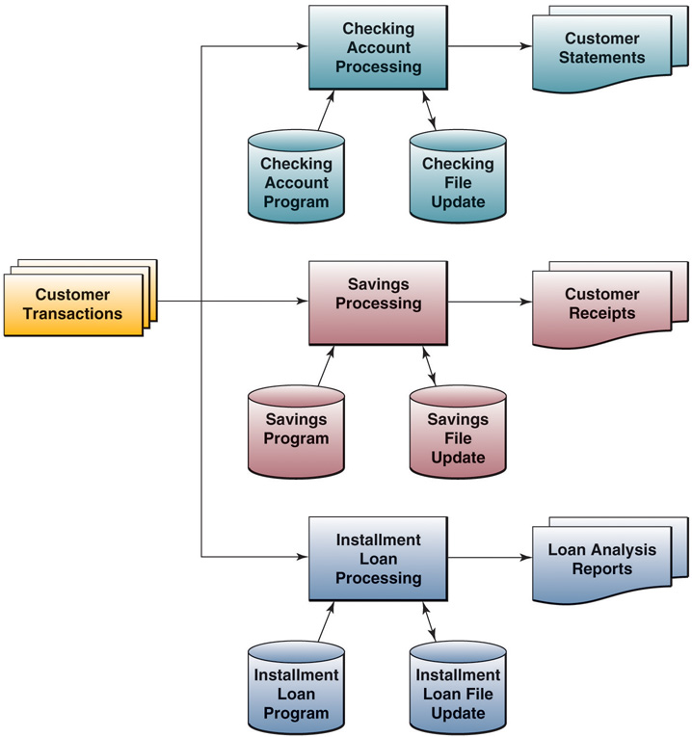
Chapter 1: The Database Environment
How did this work??

Slide 34
Chapter 1: The Database Environment
Intended database advantages
• Multiple Applications: Data Independence
• Consolidation of Data
• Minimal Duplication of Data
• Promotes Sharing of data
• Controls/checks on Data Values: Data Integrity
• Data Security
• Enforcement of data standards
• Easier Maintenance
• Quicker Development Times
• Improved decision making
• Overall Cost Savings
(Essentially, the opposite of all the problems of the file processing approach)

Slide 35
Chapter 1: The Database Environment
Cautions about Benefits
• The database approach is not a cure-all
• Specialized personnel are needed
• Increased Installation and management costs and complexity
• Conversion costs
• Need for explicit backup and recovery
• Organizational conflicts (“Information is Power”)

Slide 36
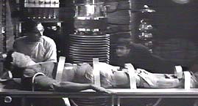
Chapter 1: The Database Environment
What is a DataBase Managment System??
A set of programs to access the data in a database
A way of allowing users/designers to (easily):
Create new data
Tables/Relations/Files/ Entity Occurrences
Records/Entity Instances
Fields/Attributes
Field/Attribute data types

Slide 37

Chapter 1: The Database Environment
What is a DBMS??
A set of programs to access the data in a database
A way of allowing users/designers to (easily):
Create new data
Manipulate data
Extract
Summarize
Analyze

Slide 38
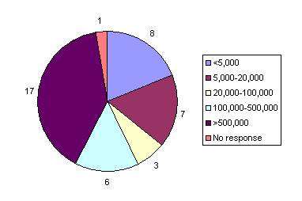
Chapter 1: The Database Environment
What is a DBMS??
A set of programs to access the data in a database
A way of allowing users/designers to (easily):
Create new data
Manipulate data
Develop Reports
Periodic
On-Demand
Push reporting
Exception

Slide 39

Chapter 1: The Database Environment
What is a DBMS??
A set of programs to access the data in a database
A way of allowing users/designers to (easily):
Create new data
Manipulate data
Develop Reports
Maintain Data
Update
Add
Delete

Slide 40


Chapter 1: The Database Environment
How did databases come about??
• 1960’s: North American Rockwell’s Moon Project
> 60% of all data used was duplicated in multiple data sets (redundancy)
• By the Mid 1960’s:
Rockwell/IBM Joint Venture to develop a DataBase Management System (DBMS)
Hierarchical in Nature
• Later:
IBM’s Information Management System (IMS)
• 1970’s-80’s: The Most Widely-used DBMS (Mainframe)

Slide 41
Chapter 1: The Database Environment
How did databases come about??
• 1971: COnference on DAta SYstems Languages (CODASYL)
• Intended to set COBOL standards
• Standards developed eventually accepted by the American National Standards Institute (ANSI)
• The DataBase Task Group (DBTG), an off-shot of CODASYL was charged with:
• Defining a set of standards for an environment which would facilitate Database creation and manipulation
• Standards developed eventually accepted by the American National Standards Institute (ANSI)

Slide 42
Chapter 1: The Database Environment
How did databases come about??
• The DBTG Report Focused on 3 Components:
• The Network Schema
• The conceptual Organization of the entire database
• The Network Subschema
• The conceptual Organization of the database as “seen” by the applications programs accessing it
• A data management program to define and manipulate the data
• 1975: The ANSI Standards Planning And Requirements Committee (SPARC) established guidelines for all NETWORK databases

Slide 43
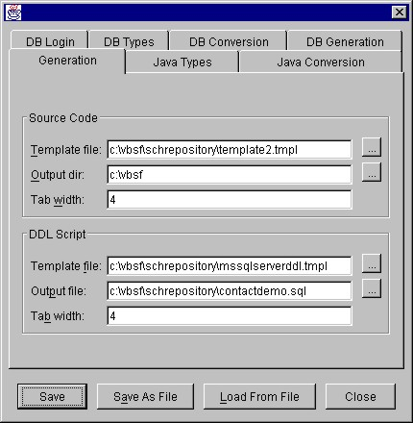
Chapter 1: The Database Environment
What are the components of a DBMS??
• Database Development
• Database Definition Languages (DDL)
• How the data is physically stored in the database
• Specification of integrity constraints
• Fixing of Access Rights (Authorization)

Slide 44
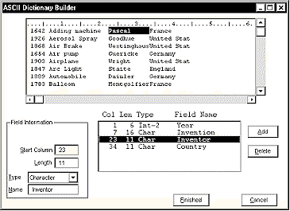
Chapter 1: The Database Environment
What are the components of a DBMS??
• Database Development
• Data Dictionary (DD)
• Field Names, data types, and relationships between tables
• Data Storage Maintenance
• Physical storage of data, forms, validation rules, etc.
• Database Transformation
• Transformation of data entered to coincide with stated data structures

Slide 45
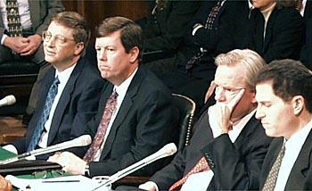
Chapter 1: The Database Environment
What are the components of a DBMS??
• Database Development
• Database Interrogation
• Query Languages
(SQL/QBE)
• Multi-user access control
(Concurrency Controls)
• Communication Interfaces
(LAN, Intranet, Internet, Extranet)

Slide 46

Chapter 1: The Database Environment
What are the components of a DBMS??
• Database Development
• Database Interrogation
• Database Maintenance
• Updating of Indices
• Database Integrity Checking/Referential Checks
• Security Management
• Backup and Recovery

Slide 47
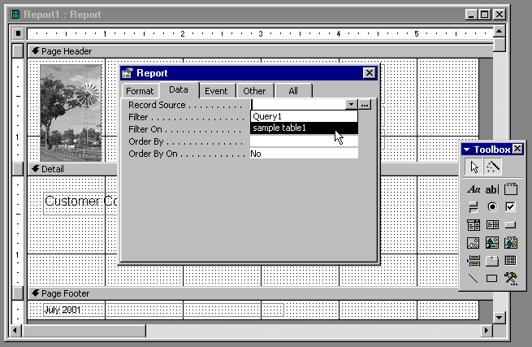
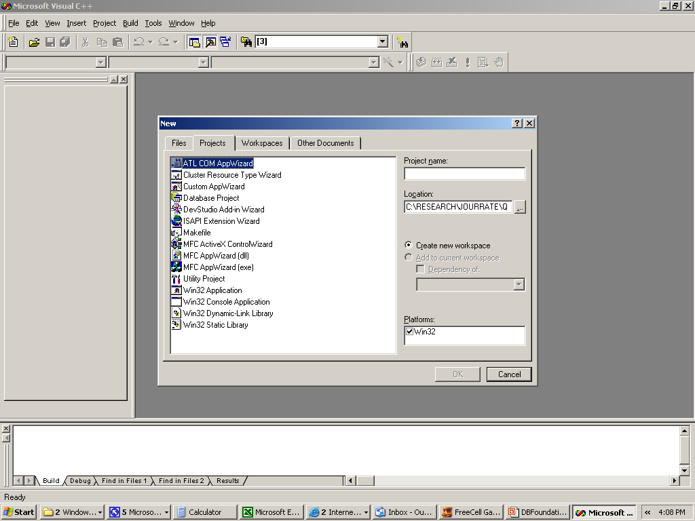
Chapter 1: The Database Environment
What are the components of a DBMS??
• Database Development
• Database Interrogation
• Database Maintenance
• Application Development
• Report Generation
• Project Development
• Data Manipulation Languages (DML)

Slide 48
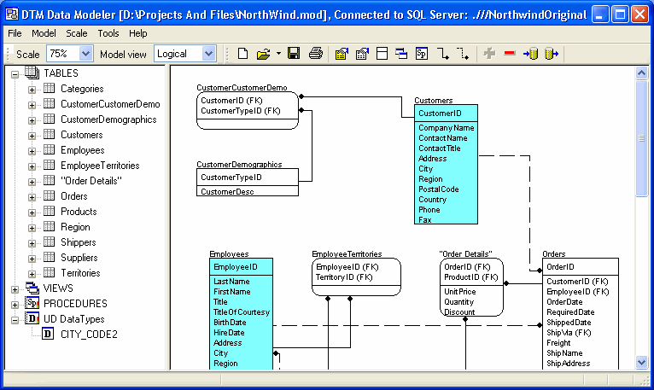
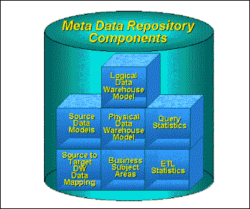
Chapter 1: The Database Environment
What’s in a typical DBMS Environment??
• Aside from the database and the DBMS:
• Computer-Aided Software Engineering (CASE) Tools
Automated tools for design of databases and applications
Data Repository
An extended set of metadata and other information important for managing databases
Primarily created and maintained by the DBMS

Slide 49
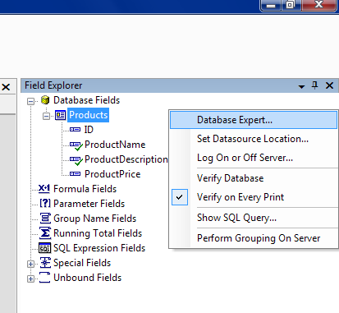
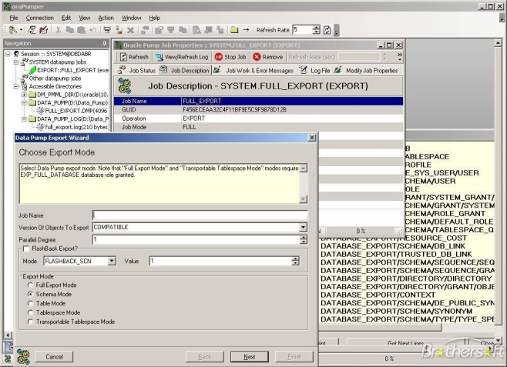
Chapter 1: The Database Environment
What’s in a typical DBMS Environment??
• Aside from the database and the DBMS:
CASE Tools
Data Repository
Application Programs
Programs used to create and maintain the database and provide information to the users
User Interfaces
Languages, menus, and other facilities by which users interact with other components in the DBMS environment

Slide 50
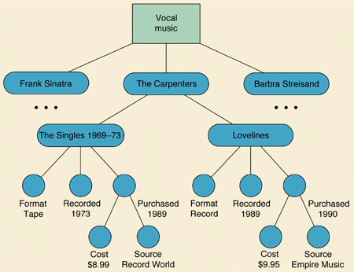
Chapter 1: The Database Environment
What types of DBMS are there??
• Hierarchical DBMS
• IBM’s IMS
• Corresponds to the idea of folders and sub-folders on your disk
• There are multiple ‘levels’, starting at the ‘root’ directory
• Note that one child (Frank Sinatra) can have ONLY one parent (Vocal Music)
• BUT a parent (The Carpenters) can have many children (‘The Singles’, ‘Lovelines’)

Slide 51
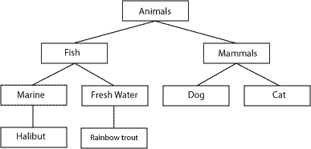
Chapter 1: The Database Environment
What types of DBMS are there??
• Hierarchical DBMS
• Notice that with Hierarchical DBMS the user MUST understand the physical structure of the database
• If you want to find a ‘Rainbow trout’, you must know that it is part of the ‘Fresh water’ subspecies of ‘Fish’ which is a type of ‘Animal’

Slide 52
Chapter 1: The Database Environment
What types of DBMS are there??
• Hierarchical DBMS
Advantages
Disadvantages
Supports 1:M relationships
Complex to manage
There is always a link between the child & parent
Did not readily support M:N conditions
(Data Integrity)
Complex Programming required
Intended to support Large Databases
Programming Requires a complete understanding of the physical database structure
Numerous ‘tried-and-true’ applications

Slide 53
Chapter 1: The Database Environment
What types of DBMS are there??
• Network DBMS
Owner
Finance Dept
Acct. Dept
CIS
Mgt. Dept
Members
Database
Anal/Design
Bus.Prog.
Telecom.
IR Mgt.
Student A
Student B
Student C
Student D
Student E
* Note: Each child can have More than one parent

Slide 54
Chapter 1: The Database Environment
What types of DBMS are there??
• Network DBMS
Advantages
Disadvantages
Supports M:M relationships
Very Difficult to design and manage
Applications can readily access all members of a set
Changes in Schema require Subschema changes
Enforces data integrity
Promotes Data Independence:
Programming Requires a complete understanding of the physical database structure
Physical changes do not require Programming Changes
Cycling:
Because everything is linked, traversing may result in ‘infinite’ looping

Slide 55

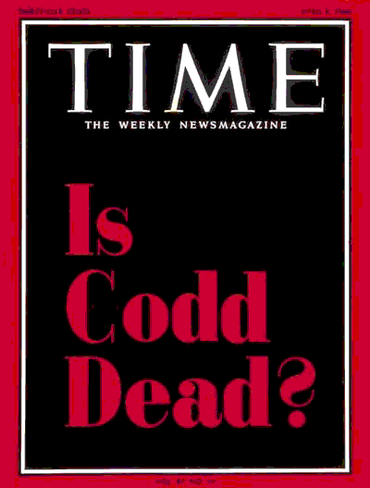
Chapter 1: The Database Environment
What types of DBMS are there??
• Relational DBMS
• At about the same time as CODASYL (1970):
• Edgar F. (Ted) Codd (of IBM) developed the Relational DataBase Management System (RDBMS)
• Based on relational algebra (hence RDMS)
• Viewed a database as a 2-dimensional table
• Attempted to ‘automate’ the functions applied to a database
• All of the physical operations necessary were performed by the DBMS
• Intended to be user-friendly
• By mid 1980’s: The most widely used database type
(Yes, 2003)

Slide 56
Chapter 1: The Database Environment
What types of DBMS are there??
• Relational DBMS
• A DBMS Approach which manages data (logically) as a collection of tables where data, and data relationships, are represented by common values in related tables
• The Most Common DBMS (especially on PCs)
dBase
Quattro
FoxPro
Access
Paradox
Oracle
• The general class of packages is referred to xBase

Slide 57
Chapter 1: The Database Environment
What types of DBMS are there??
• Relational DBMS
Consider the following table/file:
Table Student
StudentID
Name
Address
Major
123456789
Saenz, Lupe
123 Mesa
Finance
234567890
Chung, Mei
37 5th St.
INFOSYS
345678901
Adams, John
54B Hague
Accounting
456789012
Elam, Mary
123-22 E St.
INFOSYS
••••••
••••••
••••••
••••••
Field Names
Record
Field

Slide 58
Chapter 1: The Database Environment
What types of DBMS are there??
• Relational DBMS
Additional RDBMS Terminology:
Table Student
StudentID
Name
Address
Major
123456789
Saenz, Lupe
123 Mesa
Finance
234567890
Chung, Mei
37 5th St.
INFOSYS
345678901
Adams, John
54B Hague
Accounting
456789012
Elam, Mary
123-22 E St.
INFOSYS
••••••
••••••
••••••
••••••
• The Table itself is a Relation
• The Columns are tuples:
This is a 4-tuple Relation
• Flat Files consist of a set of Tuples
• The Domain of a relation is the set of legal column values

Slide 59
Chapter 1: The Database Environment
What types of DBMS are there??
• Relational DBMS
(More later)
RDBMSs are also linked to one-another
http://pkirs.utep.edu/cis4365/PPoint/StudProf.xlsx
Table Student
Primary Keys (PK)
StudentID
Name
Address
Major
Foreign Keys (FK)
123456789
Saenz, Lupe
123 Mesa
Finance
234567890
Chung, Mei
37 5th St.
INFOSYS
Primary Keys (PK)
345678901
Adams, John
54B Hague
Accounting
456789012
Elam, Mary
123-22 E St.
Accounting
••••••
••••••
••••••
••••••
Table Balance
Table Department
Student
Owed
Department
Faculty
••••••
Depart
FK
103456678
1,502.36
Marketing
987654321
••••••
Finance
PK
123456789
COBA219
Finance
876543210
••••••
INFOSYS
456789012
COBA232
Accounting
765432109
••••••
Accounting
••••••
••••••
••••••
••••••
••••••
••••••

Slide 60
Chapter 1: The Database Environment
What types of DBMS are there??
• Relational DBMS
Advantages
Disadvantages
Users need not know the physical structure
Because the DBMS does most of the work, more powerful computers needed
(Structural Independence)
Focus on logical View
Data Integrity and validity must be rigidly maintained
Allows use of Structured Query Language (SQL)
Duplication/Redundancy is unavoidable

Slide 61
Chapter 1: The Database Environment
What types of DBMS are there??
• The multidimensional model
• Three-dimensional Tables
• Each cell contains one or more simple attributes
• (Logically) grouped by categories
College C
College B
College A
StudentID
Name
Address
Major
123456789
Saenz, Lupe
123 Mesa
Finance
234567890
Chung, Mei
37 5th St.
INFOSYS
345678901
Adams, John
54B Hague
Accounting
456789012
Elam, Mary
123-22 E St.
Accounting
••••••
••••••
••••••
••••••

Slide 62
Chapter 1: The Database Environment
What types of DBMS are there??
• The Object Oriented model
• Attributes and methods/procedures are encapsulated in object classes
• New Object classes are defined from more general object classes (Inheritance)
Object Class 1
Attributes
Object Class 2
Object Class 3
Attributes
Attributes
Procedures
Procedures
Procedures

Slide 63
Chapter 1: The Database Environment
How did databases evolve??
1960’s
1970’s
1980’s
1990’s
2000’s
File Processing
Hierarchical(IBM)
Network (IBM)
Relational
Data Warehouses
Object Oriented
Object Relational
Web Enabled

Slide 64
Chapter 1: The Database Environment
Why weren’t DBMS used earlier??
• Consider an IBM 650 computer in 1956
($1.00 in 1956 = $8.32 in 2011)
The rental price for the CPU and power supply was $3,200/month
This was about the complete price of a fully loaded Cadillac
The equivalent of $26,624 in 2011
The CPU was 5ft by 3ft by 6ft and weighed 1966 lbs
The power unit was 5ft by 3ft by 6ft and weighed 2972 lbs
A shirt pocket HP-100 will run on 2 AA cells and is much faster
A card reader/punch weighed 1295 lbs and rented for $550/month
The probable operating ratio was 80% -- not guaranteed
The estimated cost of spare parts was $4000/year ($196,000 in 1998)
The 650 could add or subtract in 1.63 mill-seconds, multiply in 12.96 ms, and divide in 16.90 ms
The memory on most systems was magnetic drum with 2000 word capacity
For an additional $1,500/month youcould add magnetic core memory of 60 words with access time of .096ms

Slide 65
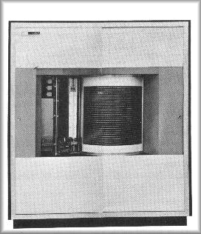
Chapter 1: The Database Environment
Why weren’t DBMS used earlier??
• Problems with RDMS
• Consider the typical computer in 1970:
Speed:
0.01 Microsecond per operation
(1,000,000/.01 = 100 MIPS)
Memory:
32K to 3MB
Secondary Storage:
Magnetic Disks … but …
The IBM 1405 Disk:
Could store up to 10 MB per disk
Had up to 50 Disks, each 2’ in Diameter
Purchase price per MB: around $10,000
(vs. $0.001 for 2009 disk drives)
(And this was considered a HUGE improvement)
IBM 1405 Disk Storage

Slide 66
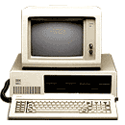
66
Chapter 1: The Database Environment
Why weren’t DBMS used earlier??
• It was even worse for PCs: Consider the 1st IBM PC (1983):
Intel 8080 CPU operating at 4.77 MHz
64K Ram
1 5¼” Floppy Drive (No Hard Drive)
B/W (Green, really) Monitor
Approximate cost: $5,000 *
Still ….
65,000 units sold by the end of the year.
23% Market Share by the end of 1984

Slide 67

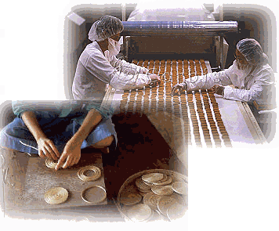
Chapter 1: The Database Environment
What types of databases are there??
• Operational Databases
• Detailed Information to Support ongoing business operations
• Subject Area DataBases (SADB), Transaction Databases, Production Databases
• Each Division receives the data that they require for their specific needs

Slide 68

Chapter 1: The Database Environment
What types of databases are there??
• Operational Databases
• Analytical Databases
• Management Databases, Informational Databases, Multi-dimensional Databases, Statistical Databases
• Information needed by managers and other end-users
• On-Line Analytical Processing (OLAP), Decision Support Systems (DSS), and Executive Information Systems (EIS)

Slide 69
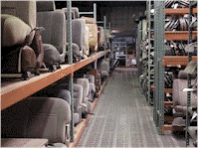
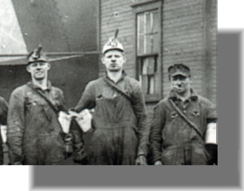
Chapter 1: The Database Environment
What types of databases are there??
• Operational Databases
• Analytical Databases
• Data Warehouses
• Central Source of data extracted from various databases
• a data mart's data is targeted to a smaller audience of end users or used to present information on a smaller scope.
(Some argue that a DM is a subset of DW; Others argue that the difference is trivial)
• Data Mining: Data processed from a variety of Sources to identify operational, managerial and strategic trends

Slide 70
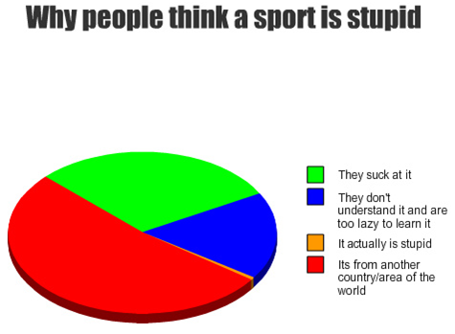
Chapter 1: The Database Environment
What types of databases are there??
• Operational Databases
• Analytical Databases
• Data Warehouses
• Business Intelligence (BI): Computer-based techniques used in spotting, digging-out, and analyzing business data, such as sales revenue by products and/or departments, or by associated costs and incomes (from Wikipedia).
Provides historical, current, and predictive views of business operations

Slide 71
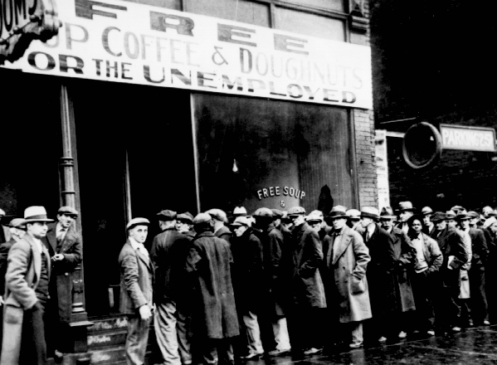
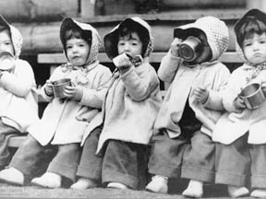
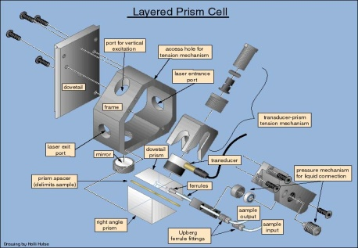
Chapter 1: The Database Environment
What types of databases are there??
• Operational Databases
• Analytical Databases
• Data Warehouses
• Distributed Databases
• Replication of corporate databases
• Each Division receives the entire database which is reassembled at some specified time period
• Partitioning of corporate databases
• Each Division receives only the needed parts of the database which (again) is reassembled at some specified time period

Slide 72
Chapter 1: The Database Environment
What types of databases are there??
• Query Optimization in Distributed Databases
• Consider the following situation
SUPPLIER (Supplier-Number, City)
10,000 records in Detroit
SHIPMENT (Supplier-Number, Part-Number)
100,000 records in Chicago
PART (Part-Number, Color)
1,000,000 records in Detroit
• Options Times
Move PART to Detroit for processing 16.7 Min
Move Supplier & Shipment to Chicago for processing 28 Hr.
Join
• Partitioning of corporate databases
• Each Division receives only the needed parts of the database which (again) is reassembled at some specified time period

Slide 73


Chapter 1: The Database Environment
What types of databases are there??
• Operational Databases
• Analytical Databases
• Data Warehouses
• Distributed Databases
• End-User Databases
• Shared Data gathered by individuals
• Shared Applications developed by individuals
• External Databases
• Commercial/Shareware/Free
• Dominated (now) by the Internet

Slide 74

Chapter 1: The Database Environment
What types of databases are there??
• Operational Databases
• Analytical Databases
• Data Warehouses
• Distributed Databases
• End-User Databases
• External Databases
• Web-based Databases (Cloud computing)
A style of computing in which dynamically scalable and often virtualized resources are provided as a service over the Internet. Users need not have knowledge of, expertise in, or control over the technology infrastructure in the "cloud" that supports them. (definition taken from WIKIPEDIA)
For a good article see: http://www.sis.pitt.edu/~gray/LIS2600/references/MS_cloudComputing.htm

Slide 75


Chapter 1: The Database Environment
Where are databases being used??
• Personal Computer Databases
Can Improve Individual Performance
Not readily Shared with Others
• Workgroup Databases
• Small Group of individuals working together on a project
• Usually LAN-Based
Project Manager
System Developers
Remote Users
Librarian
LAN
Database Server
Workgroup Database

Slide 76
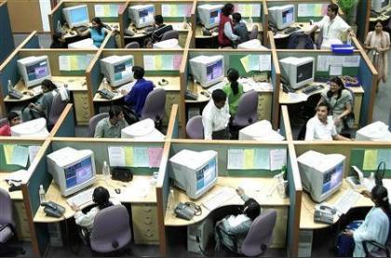
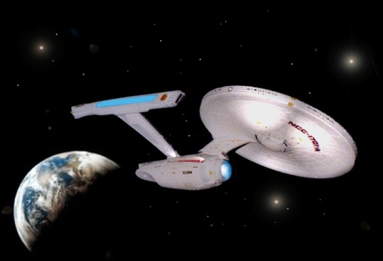
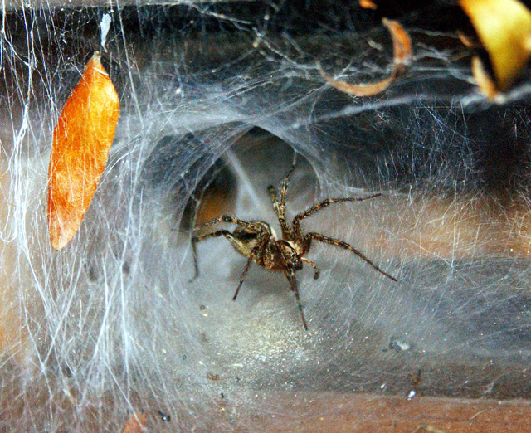
Chapter 1: The Database Environment
Where are databases being used??
• Personal Computer Databases
• Workgroup Databases
• Departmental Databases
• Dedicated to functional unit purposes (larger workgroups)
• Enterprise Databases
• Corporate-wide
• Web Enabled Databases
• Fastest/Largest areas of growth
• Includes all e-commerce transactions
• Typically updated in real-time

Slide 77
Chapter 1: The Database Environment
What are the trends databases??
• Management of increasing complex data types
Multidimensional Data
• Universal Servers
Increased Web computing
• Fully distributed databases
Due to decreased telecommunications costs and ease of accessing remote data
• Content-addressable storage
The user can retrieve data they specify rather than how to retrieve it
E.g., the user can scan a picture and have the computer search all data locations for matches
• Extended use of technology advances
E.g., the user can use voice recognition to access data
(“Computer – save the world”)

Slide 78
Chapter 1: The Database Environment
What are the trends databases??
• Management of increasing complex data types
• Universal Servers
• Fully distributed databases
• Content-addressable storage
• Extended use of technology advances
• Improvements in data mining algorithms
Efficient analysis of huge data stores
• Improved synchronization of data between devices
E.g., Wi-Fi transmission of data between computers, telephones, PDAs
• Increased usage with improved, reliable XML services
• Improved ability to reconstruct historical events
E.g., Sarbanes-Oxley

Slide 79
Chapter 1: The Database Environment
What are the trends databases??
• Management of increasing complex data types
• Universal Servers
• Fully distributed databases
• Content-addressable storage
• Extended use of technology advances
• Improvements in data mining algorithms
• Improved synchronization of data between devices
• Increased usage with improved, reliable XML services
• Improved ability to reconstruct historical events
• Some Challenges
Security
Database Backup and recovery
Grid computing: the combination of computer resources from multiple sources applied to a common task (usually scientific, technical or busi-ness oriented) that requires a great number of computer processing cycles or the need to process large amounts of data. (WIKI)

Slide 80

Chapter 1: The Database Environment
What are the trends databases??

Slide 81
Chapter 1: The Database Environment
Database Summary
• Databases are easy
Given the available DBMSs, if you put a chimpanzee in front of a terminal, s/he will be able to construct a working database
• Databases are difficult
Construction of an effective and efficient database requires considerable knowledge and skills

Slide 82

Chapter 1: The Database Environment
QUESTIONS???

