Slide 1

CIS 4365 Entity Relationship Diagrams
Chapter3:
Entity-Relationship Modeling:
Part 1

Slide 2

CIS 4365 Entity Relationship Diagrams
• The Entity Relationship Diagram (ERD)
• Developed by Chen (1976)
• THE Most commonly used data modeling tool
• Shows the structure, requirements and constraints of the intended system, independent of software (DBMS), at a higher level of abstraction
• Tool for communications between database designers and users
• Also used as a planning/organization tool

Slide 3


A Quick Aside:
• How many times have you been shown a model in a class only to find out it is useless ??
Too Many !!!
• This is NOT one of those times ---
• ERDs form the foundation of all database modeling
• It is IMPOSSIBLE to develop a working Database without them

Slide 4
CIS 5365 Entity Relationship Diagrams
Basic ERD Symbols
• Anything about which we wish to maintain information
Entity
Person
Thing
Event
Place
Object
Description
• Entity Instance: A single occurrence of the entity (record)
• Entity Type: A collection of entity instances
• An association (or action which occurs) between Entity types
Relationship
Customers place orders
Orders contain parts
• Fields within a Record (entity instance)
Attributes
CUSTOMER(custid, name, address)
• Connectors between other elements

Slide 5
CIS 5365 Entity Relationship Diagrams
A Simple ERD:
• Consider the following description:
“A customer places an order. The order consists of parts.”
Entity
Relationship
Another Relationship
Customer
Places
Orders
Contain
An Association between Entities
Another Entity
Parts
Someone whom we wish to keep information about

Slide 6

CIS 5365 Entity Relationship Diagrams
• PROBLEM: The model does not clearly show how the entity instances are related
(Cardinality)
How many parts can one order contain?
Places
Contain
1
M
M
Customer
Orders
How many orders can a customer place?
How many customers are associated with an order?
A One-to-Many (1:M) Relationship
M
Parts
How many parts can be in one order?
A Many-to-Many (M:M) Relationship

Slide 7
CIS 5365 Entity Relationship Diagrams
Alternative Notation
Given 1 Order, How many parts can it contain??
Many
Customer
Places
Orders
Contain
One
Given 1 Customer, how many Orders can be placed ??
Given 1 Order how many cust- omers placed it?
Many
Many
Parts
Given 1 part, How many orders can contain it ??

Slide 8
CIS 5365 Entity Relationship Diagrams
Degree of Relationship: Number of Entities Participating
• Binary Relationships (degree 2): Thought to be most common
Places
1
M
Customer
Orders
a 1:M Binary Relationship
Contain
M
M
Orders
Parts
a M:M Binary Relationship
Occupies
1
1
Student
Seat
a 1:1 Binary Relationship
(commonly a lookup table)

Slide 9
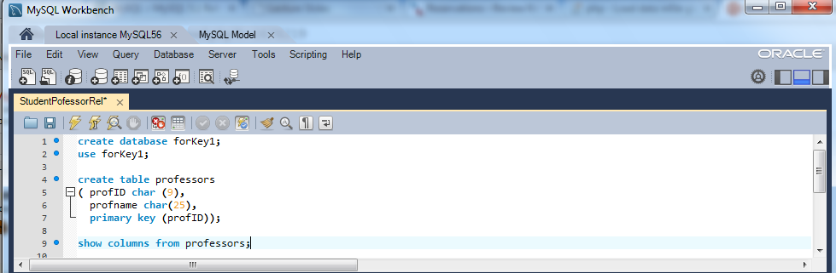
CIS 5365 Entity Relationship Diagrams
Your First SQL (mysql) program:
• Let’s build a script for a 1:M relation (remember how we previously related students with faculty??)
Open your MySql Workbench
Enter the following code:

Slide 10
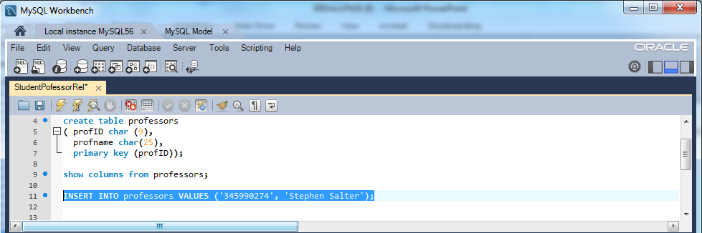
CIS 4365 Entity Relationship Diagrams
Your First SQL (mysql) program:
• It’s time to populate your database (insert the data)
• One way to do this is with the ‘insert into’ command
• For example, to enter a professor, we would use the command:
INSERT INTO professors VALUES ('345990274', 'Stephen Salter');
• Enter in the values above into your workbench
• Execute the command

Slide 11
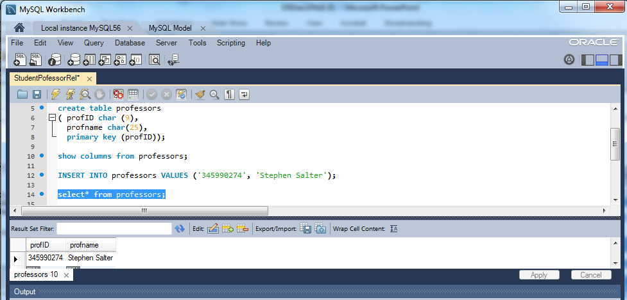
CIS 4365 Entity Relationship Diagrams
Your First SQL (mysql) program:
• Check to see if you were successful:

Slide 12
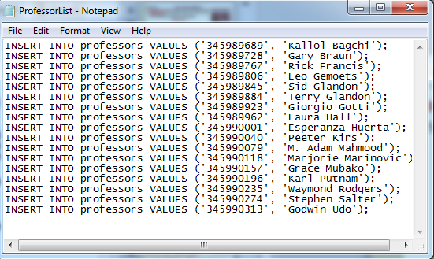
CIS 4365 Entity Relationship Diagrams
Your First SQL (mysql) program:
• To save you some time, I have put all of the insert commands in a file which you can download here: ProfessorList
• The complete file looks like this:

Slide 13
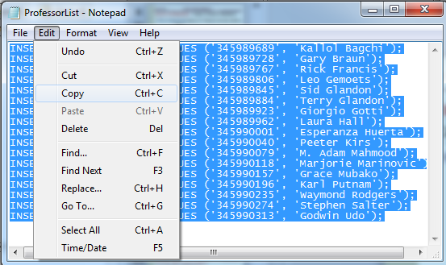
CIS 4365 Entity Relationship Diagrams
Your First SQL (mysql) program:
• Copy all of the records:

Slide 14
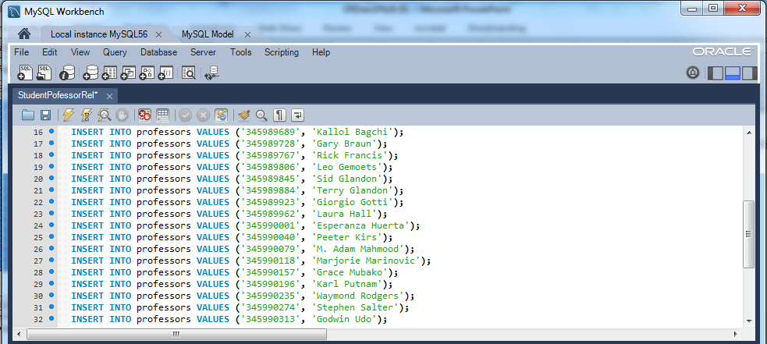
CIS 4365 Entity Relationship Diagrams
Your First SQL (mysql) program:
• And paste them into your script:

Slide 15
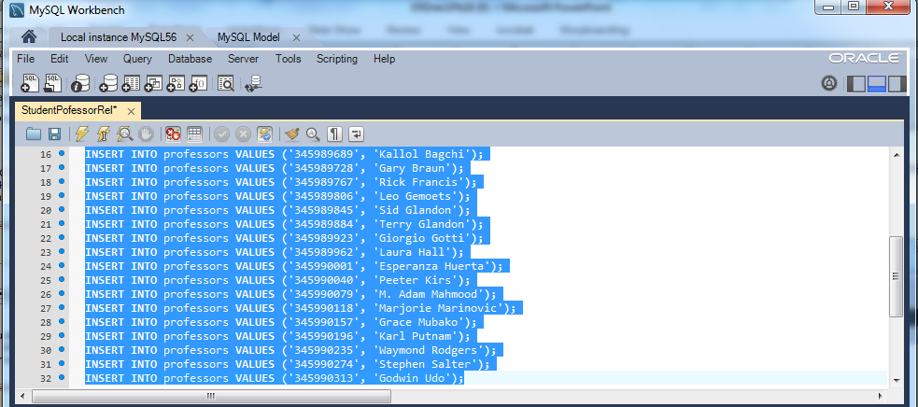
CIS 4365 Entity Relationship Diagrams
Your First SQL (mysql) program:
• Highlight all the records you just entered:
• and execute the commands

Slide 16
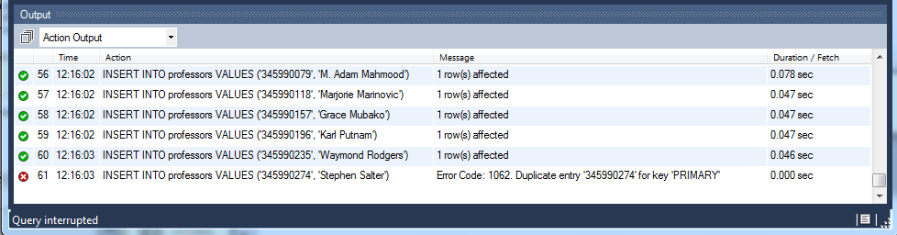
CIS 4365 Entity Relationship Diagrams
Your First SQL (mysql) program:
• If have have been following my instructions, you should have gotten an error message:
Why ???

Slide 17
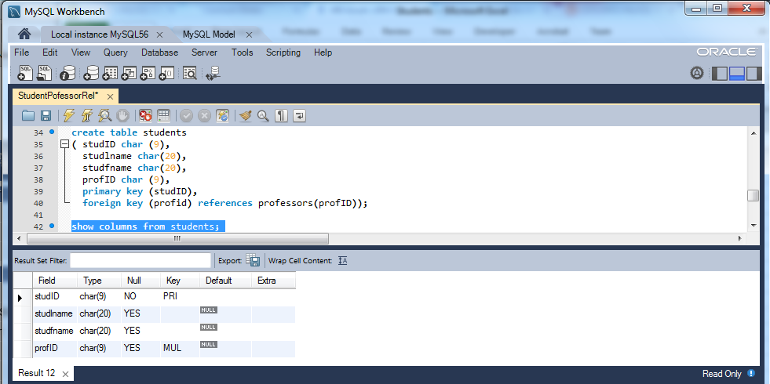
CIS 4365 Entity Relationship Diagrams
Your First SQL (mysql) program:
• We need to create a new table: Students

Slide 18
CIS 4365 Entity Relationship Diagrams
Your First SQL (mysql) program:
• Notice that this table MUST be created AFTER table professors
Why ???
• I have created a file for you (called students.csv), which looks like this:
(there are 100 records)

Slide 19
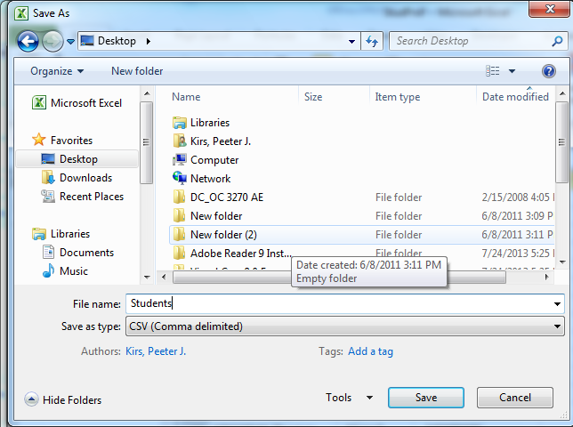
CIS 4365 Entity Relationship Diagrams
Your First SQL (mysql) program:
• You will need to open the file and save it to your desktop as a CSV file)

Slide 20
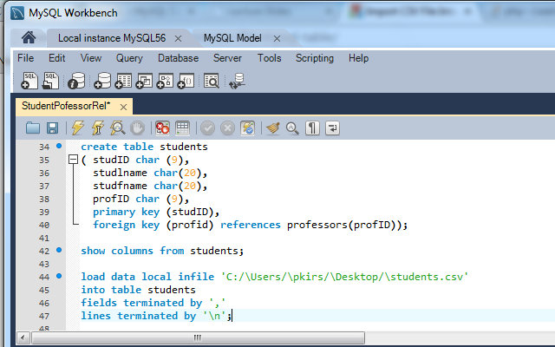
CIS 4365 Entity Relationship Diagrams
Your First SQL (mysql) program:
• Enter the following lines of code:
• And execute

Slide 21
CIS 4365 Entity Relationship Diagrams
Your First SQL (mysql) program:
• NOTE: I forgot one command. The load command should be:
load data local infile 'C:/\Users/\pkirs/\Desktop/\students.csv'
into table students
fields terminated by ','
enclosed by '"‘
lines terminated by '\n';
enclosed by ‘ “ ‘

Slide 22
CIS 4365 Entity Relationship Diagrams
Your First SQL (mysql) program:
• Once again, if have have been following my instructions, you should have gotten an error message:
Why ???
• Consider the following student entry
100238226 | Pérez | Anthony | 345990313
• Where the value 345990313 is the foreign key referring to the professors table (this foreign key in table students points to the primary key in table professors which is associated with Dr. Udo)

Slide 23
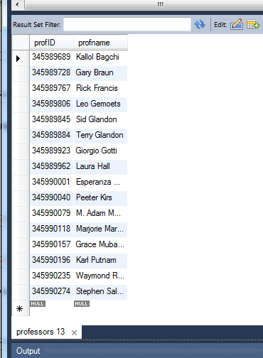
CIS 4365 Entity Relationship Diagrams
Your First SQL (mysql) program:
• go back to your workbench and get a list of all professors
select * from professors;
Where is Dr Udo ???

Slide 24
CIS 4365 Entity Relationship Diagrams
Your First SQL (mysql) program:
• Remember what happened earlier:
• We entered Dr. Salter first
• Then we entered the complete list of professors (including Dr. Salter, again.
• We then received the error message
• No records following Dr. Salter (i.e., Dr. Udo) were entered

Slide 25
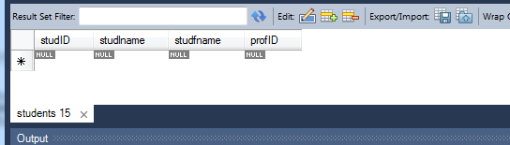
CIS 4365 Entity Relationship Diagrams
Your First SQL (mysql) program:
How do we fix that ???
• Adding Dr. Udo to the list of professors is easy
INSERT INTO professors VALUES ('345990313', 'Godwin Udo');
(Please Do enter him into your table)
• But let’s take a look at our student table
select * from students;
• When we look at the output, we find:

Slide 26
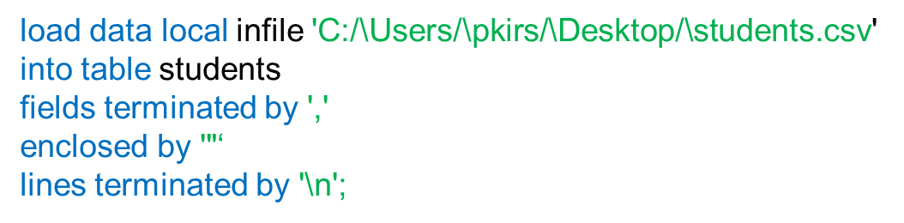
CIS 4365 Entity Relationship Diagrams
Your First SQL (mysql) program:
• go back and reenter your student data:
• Your output should appear approximately as it does on the following slide

Slide 27
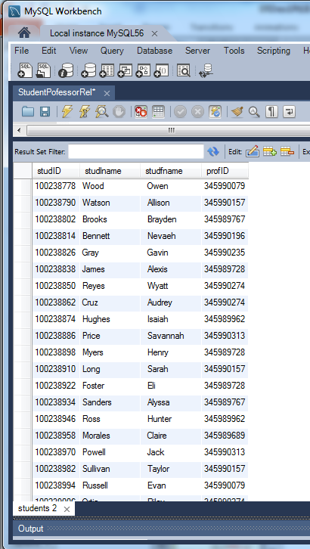
CIS 4365 Entity Relationship Diagrams

Slide 28
CIS 4365 Entity Relationship Diagrams
Your First SQL (mysql) program:
• Its time join the tables together and print out some results
• Enter the following query:
select studlname, studfname, profname
from students, professors
where students.profID = professors.profID
order by studlname;

Slide 29
CIS 4365 Entity Relationship Diagrams
Your First SQL (mysql) program:
• You should have obtained a large number of output lines (100) from your query.
• let’s modify our query so that we get only students who have had either Dr. Bagchi or Dr. Gemoets as a professor.
select studlname, studfname, profname
from students, professors
where students.profID = professors.profID
and (student.profID = '345989689‘
or student.profID = ‘345989806’)
order by studlname;

Slide 30
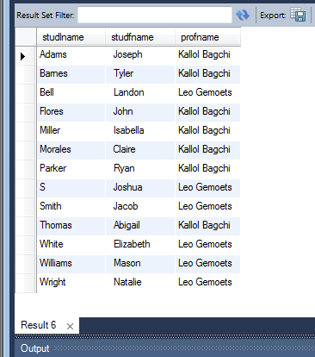
CIS 4365 Entity Relationship Diagrams
Your First SQL (mysql) program:
• Your Output should appear as:

Slide 31
CIS 5365 Entity Relationship Diagrams
Degree of Relationship: Number of Entities Participating
• Other Relationships
a 1:M Unary Relationship
a M:M:M Ternary Relationship
a M:M:M:M Relationship Degree Four
More on these later

Slide 32
CIS 5365 Entity Relationship Diagrams
Cardinality Constraints
An Order MAY (OPTIONAL) contain many parts.
Customer
Places
Orders
Contain
A Customer MAY (OPTIONAL), place more than 1 order.
An Order MUST (MANDATORY) be placed by one customer
Parts
NOTE:
While we will occasionally use Cardinality constraints (so that you can learn them) they will NOT be required in ERDs that you turn in
A Part MUST (MANDATORY) be contained in many orders

Slide 33
CIS 5365 Entity Relationship Diagrams
Additional Notation
Customer
Strong Entity
An Entity which is not dependent upon other entities
Orders
Weak Entity
An Entity which exits only because of another entity
Customer
Places
Orders
Identifying Relationship
NOTE:
Once again, we will occasionally use this notation (so that you can learn them) they will NOT be required in ERDs that you turn in

Slide 34
CIS 5365 Entity Relationship Diagrams
Associating Attributes With Entities
Simple Attribute
Customer_Name
Customer
An attribute (field) that is functionally dependent upon the primary key:
• Your name, address, GPA, and many other attributes (all simple attributes) are functionally dependent on your SSN/Student ID
• If I know your SSN/Student ID, I know your name, address, and other simple information

Slide 35
CIS 5365 Entity Relationship Diagrams
Associating Attributes With Entities
Simple Attribute
Derived Attribute
Customer_Name
Yrs_in_Business
Customer
The number of years in business is not actually stored, but will be calculated when displayed
The date established (a numerical value) is stored and then subtracted from the present date (also a numerical value)

Slide 36
CIS 5365 Entity Relationship Diagrams
Associating Attributes With Entities
Simple Attribute
Derived Attribute
Customer_Name
Yrs_in_Business
Customer
Customer_ID
Primary Key
The unique identifier for each record

Slide 37
CIS 5365 Entity Relationship Diagrams
Associating Attributes With Entities
Simple Attribute
Derived Attribute
Customer_Name
Yrs_in_Business
Customer
Customer_ID
Employer
Primary Key
Foreign Key
A link to a unique identifier in a different table
How??
An Excel Example:
http://pkirs.utep.edu/cis4365/PPoint/StudProf.xlsx

Slide 38
CIS 5365 Entity Relationship Diagrams
Associating Attributes With Entities
Simple Attribute
Derived Attribute
Customer_Name
Yrs_in_Business
Customer
Customer_ID
Employer
Primary Key
Foreign Key
Address
Composite Attribute
An attribute which contains a fixed number of additional attributes, sometimes shortened as:
Street
City
State
Address

Slide 39
CIS 5365 Entity Relationship Diagrams
Associating Attributes With Entities
Simple Attribute
Derived Attribute
Customer_Name
Yrs_in_Business
Multivalued Attribute
Customer
Purch_Agts
Customer_ID
Employer
Primary Key
Foreign Key
Address
Composite Attribute
What’s the difference between Multivalued and Composite Attributes??
Street
City
State

Slide 40
CIS 5365 Entity Relationship Diagrams
Composite Attributes
Address
Composite attributes have a fixed number of attributes associated with it
Street
City
State
• e.g. Street, City, State, Zipcode
They are often used in the initial design of a database because while the designer knows that there will be a fixed number, s/he might not be sure exactly what attributes will be included
Sometimes drawn as:
Address
Street
City
State
• e.g. Should we also include apartment number and country?

Slide 41
CIS 5365 Entity Relationship Diagrams
Multivalued Attributes
Multivalued attributes have a Variable number of attributes associated with it
Purch_Agts
Assume you are a salesman. Your clients are of different sizes:
• At a 7-11, you have one purchasing agent to deal with
• At UTEP, you have twelve purchasing agent to deal with
• At Fort Bliss, you have forty-six purchasing agent to deal with
These are known as Repeating Groups, and will require refinement (more later)
Customer
Customer ID | First Name | Surname | Telephone No.
123 | Robert | Ingram | 555-861-2025
456 | Jane | Wright | 555-403-1659
 |  |  | 555-776-4100
789 | Maria | Fernandez | 555-808-9633

Slide 42

CIS 5365 Entity Relationship Diagrams
Yet Another Notation Method
There is one more we need to know about:
UML (Unified Modeling Language)
• Set of OO modeling conventions that are used to specify or describe software systems
• Attempt to create a single, standard process
• Provides notation for OO Modeling
Does NOT prescribe a method for developing Systems
• Adopted by the Object Management Group as the industry standard in 1997
Still often referred to as a ‘work in progress’

Slide 43
CIS 5365 Entity Relationship Diagrams
Yet Another Notation Method
In UML, we might represent our relationship as:
Customer
CustID
Name
Street
City
State
Zipcode
Places
Contain
Parts
Orders
1 .. *
OrdID
~CustID
PartID
x Others
* .. *
Relationship Notation:
1 One and only one
* Any number from 0 to infinity
0..1 Either 0 or 1
n..m Any number in the range n to m inclusive
1..* Any positive integer
Attribute Notation:
• Primary Key
~ Foreign Key
x Composite Attribute

Slide 44
CIS 5365 Entity Relationship Diagrams
Additional Relationships
• Consider the relationship between the Part that a Vendor (wholesaler) ships to a Store
M
M
M
Vendor
Parts
Sells
Shipped to
A Vendor sells many Parts
The same Part can be sold by many Vendors
A M:M Relationship
M
A Part can be shipped to many Stores
Stores
Stores can hold to many Parts
Also a M:M Relationship

Slide 45
CIS 5365 Entity Relationship Diagrams
Additional Relationships
• Assume that the same Hammer is sold by six different Vendors
M
M
M
Vendor
Parts
Sells
Shipped to
• Assume that these Hammers may (or may not) be sent to any Home Depot stores in El Paso (let’s assume that there are 10 Home Depots in El Paso)
M
Stores
Do we know what Hammer came from what Vendor???

Slide 46
CIS 5365 Entity Relationship Diagrams
Additional Relationships
• The three entities are interdependent (A simultaneous relationship)
• Can a Vendor exist if there are no Parts to sell?
• Can a Vendor exist if there are no Stores to sell their Parts to?
• Can a Part exist if there are no Vendors to sell them?
• Can a Store exist if there are no Parts?
This is a TERNARY relationship (i.e., a relationship of degree three)

Slide 47
CIS 5365 Entity Relationship Diagrams
How do we determine cardinality?
Parts
Vendor
Supplies
Store
Given 1 vendor and 1 part, how many Stores?
Many
Given 1 Store and 1 vendor, how many parts?
Many
Given 1 Store and 1 part, how many vendors?
Many
Hence a M:M:M ternary relationship

Slide 48
CIS 5365 Entity Relationship Diagrams
What about cardinality constraints?
Parts
Vendor
Supplies
Store
Given 1 vendor and 1 part, MUST there be many Stores?
NO
Given 1 Store and 1 vendor, MUST there be many parts?
NO
Given 1 Store and 1 part, MUST there be many vendors?
NO
The TRUE solution lies in the actual situation

Slide 49
CIS 5365 Entity Relationship Diagrams
Another Relationship
• Suppose UTEP wished to track employees who were married to each other (e.g., for insurance purposes)
• We could set up a binary relationship
An Employee may have 1 spouse
A Spouse CAN have ONLY 1 Employee
Is Married to
Employee
Spouse
Spouse SSN
SSN
Addr.
SSN
Addr.
But, Each Entity Type has the same attributes

Slide 50
CIS 5365 Entity Relationship Diagrams
Another Relationship
• We could create a Unary relationship
An Employee May be married
Is Married to
Employee
A Spouse Must be married
How would the tables in this relationship look like?
ESSN | Street | City | State | SSSN
123456789 | 123 Mesa | El Paso | TX | 987665432
234567890 | 94 Rim Rd. | El Paso | TX | NULL
276899217 | 120 Loman | Anthony | NM | 567890123
329801442 | 19 Texas St. | El Paso | TX | NULL
488912351 | 678 Main | Chaparelle | NM | NULL
567890123 | 120 Loman | Anthony | NM | 276899217
987665432 | 123 Mesa | El Paso | TX | 123456789
Aren’t we duplicating too much data, like Addresses?

Slide 51
CIS 5365 Entity Relationship Diagrams
Another Relationship
• We could also create a Lookup Table
Address
Lives at
See Vlookup Spreadsheet
Is Married to
Employee
• Where the tables would appear as:
Table Employee
Table Address
ESSN | Address | SSSN
123456789 | 323 | 987665432
234567890 | 189 | NULL
276899217 | 124 | 567890123
329801442 | 204 | NULL
488912351 | 123 | NULL
567890123 | 124 | 276899217
987665432 | 323 | 123456789
Add. No. | Street | City | State
*** | *** | *** | ***
123 | 678 Main | Chaparelle | NM
124 | 120 Loman | Anthony | NM
*** | *** | *** | ***
189 | 94 Rim Rd. | El Paso | TX
*** | *** | *** | ***
204 | 19 Texas St. | El Paso | TX
*** | *** | *** | ***
323 | 123 Mesa | El Paso | TX
*** | *** | *** | ***
The Question is: Should we??

Slide 52
CIS 5365 Entity Relationship Diagrams
Another Relationship
• That is a decision for the DBA, based on:
• How many employees share a common address?
(I don’t think there are too many UTEP employees who are married to each other – But what do I know!!!)
Unary relationships may take on any cardinality
• 1:1 An Employee is married to another Employee
(In a Polygamist/Polyandrist society, this is a 1:M relationship)
Don’t forget: It depends on what is actually taking place!
• 1:M An Employee manages many other Employees
• M:M Parts contain other Parts
(This relationship is a Recursive relationship)

Slide 53
CIS 5365 Entity Relationship Diagrams
Another Relationship
• Consider another example:
“At this college, there are many departments. Each department has a number of faculty members, and a faculty member may belong to only one department. In each department, there is one faculty member assigned to supervise the other faculty members”.
• Let’s build the ERD in stages
Keep in mind that there are many ways to arrive at the same solution (Equifinality)

Slide 54
CIS 5365 Entity Relationship Diagrams
Another Relationship
We know that we have Departments which consist of Faculty
Both must be entity types, since we wish to keep information about them
We also know that Departments have many Faculty and that each Faculty may belong to a single Department
Department
Consists of
Faculty
Given 1 Department, how many faculty members?
Many
Given 1 Faculty member, how many departments?
One

Slide 55
CIS 5365 Entity Relationship Diagrams
Another Relationship
We also know that a Faculty member is designated as another Faculty member’s supervisor.
Our ERD might now appear as:
Department
Consists of
Faculty
Supervises
One faculty member MUST supervise many other faculty members
Each faculty member MUST be supervised by ONLY ONE other faculty member

Slide 56
CIS 5365 Entity Relationship Diagrams
Another Relationship
We will need one additional relationship:
“The faculty member who supervises other faculty is also responsible for managing the department”
Department
Consists of
Faculty
Supervises
Manages
Given 1 Department, how many faculty managers?
One (and only one)
Given 1 Faculty, how many Departs. does s/he manage?
One (or none)
How would the tables in this relationship look like?

Slide 57
CIS 5365 Entity Relationship Diagrams
Another Relationship
Department
Consists of
Faculty
Supervises
Manages
Faculty
FacID | Name | Super
123 | Salter | 678
234 | Roth | 234
345 | Kirs | 519
456 | Postulma | 901
519 | Gemoets | 901
532 | Eliot | 234
554 | Udo | 519
602 | Braun | 678
678 | Zimmerman | 678
789 | Bagchi | 519
890 | Fernandez | 901
901 | Hadjimarku | 901
Department
DeptID | Mgr
Acct. | 678
Econ/Fin | 234
IDS | 519
Mgt/Mkt | 901

