Slide 1
Joining Spreadsheet data in Excel
LName | Fname
Smith | James
Johnson | Mary
Williams | John
Jones | Patricia
Brown | Robert
Davis | Jennifer
Miller | Michael
Wilson | Elizabeth
Moore | William
Taylor | Linda
Anderson | David
Thomas | Barbara
Jackson | Richard
White | Susan
Harris | Joseph
Martin | Jessica
Thompson | Thomas
Garcia | Margaret
Martinez | Joseph
Robinson | Sarah
Lname | Fname
Clark | Daniel
Rodriguez | Nancy
Lewis | Matthew
Lee | Betty
Walker | Anthony
Rodriguez | Juan
Allen | Dorothy
Young | Mark
Hernandez | Sandra
Clark | Mary
I want to know which students were taught by which instructors
How can I do that??
This is a list of Instructors
Basically, I can’t because there is no common thread (common fields) between the two data sets
These are stored in different spreadsheets, but in the same workbook
This is a list of Students

Slide 2
Joining Spreadsheet data in Excel
Let’s modify the data sets slightly so that there is a common field between the data sets
Students
Instructors
LName | Fname | Instruct | Instruct. Name
Smith | James | 2033
Johnson | Mary | 1089
Williams | John | 2282
Jones | Patricia | 2033
Brown | Robert | 2733
Davis | Jennifer | 2989
Miller | Michael | 2033
Wilson | Elizabeth | 2109
Moore | William | 1094
Taylor | Linda | 2248
Anderson | David | 1089
Thomas | Barbara | 2109
Jackson | Richard | 2282
White | Susan | 2733
Harris | Joseph | 2989
Martin | Jessica | 2592
Thompson | Thomas | 2592
Garcia | Margaret | 2989
Martinez | Joseph | 2733
Robinson | Sarah | 2282
IID | Lname | Fname
1089 | Clark | Daniel
1094 | Rodriguez | Nancy
2033 | Lewis | Matthew
2109 | Lee | Betty
2248 | Walker | Anthony
2282 | Rodriguez | Juan
2472 | Allen | Dorothy
2592 | Young | Mark
2733 | Hernandez | Sandra
2989 | Clark | Mary
This is a primary key in instructors
(each value must be unique)
Why??
We now have a field in common

Slide 3
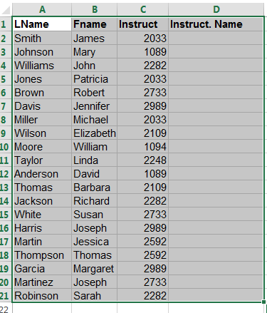
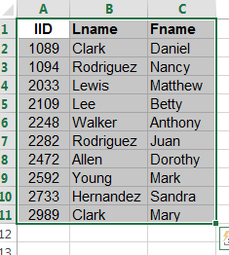
Joining Spreadsheet data in Excel
Excel has a function that will allow us to join the data: vlookup
This is in spreadsheet ‘Students’
This is in spreadsheet ‘Instructors’
For each student, we want to look up the value that appears in the Instruct field (Column C) and find it in the ‘Instructors’ spreadsheet in column A (IiD) and return the instructors Lname and put it in column D (Instruct. Name).

Slide 4
Joining Spreadsheet data in Excel
Excel has a function that will allow us to join the data: vlookup
This is in spreadsheet ‘Students’
This is in spreadsheet ‘Instructors’
For example, in cell D2, we would enter the formula :
=VLOOKUP(C2,Instructors2!$A$2:$C$11,2,FALSE)
And then copy the formula in D2 into cells D3:D21

Slide 5
Joining Spreadsheet data in Excel
The result would be
LName | Fname | Instruct | Instruct. Name
Smith | James | 2033 | Lewis
Johnson | Mary | 1089 | Clark
Williams | John | 2282 | Rodriguez
Jones | Patricia | 2033 | Lewis
Brown | Robert | 2733 | Hernandez
Davis | Jennifer | 2989 | Clark
Miller | Michael | 2033 | Lewis
Wilson | Elizabeth | 2109 | Lee
Moore | William | 1094 | Rodriguez
Taylor | Linda | 2248 | Walker
Anderson | David | 1089 | Clark
Thomas | Barbara | 2109 | Lee
Jackson | Richard | 2282 | Rodriguez
White | Susan | 2733 | Hernandez
Harris | Joseph | 2989 | Clark
Martin | Jessica | 2592 | Young
Thompson | Thomas | 2592 | Young
Garcia | Margaret | 2989 | Clark
Martinez | Joseph | 2733 | Hernandez
Robinson | Sarah | 2282 | Rodriguez
We have a slight problem: Consider Instructor Rodriguez. Is it Nancy Rodrigues or Juan Rodriguez ??

Slide 6
Joining Spreadsheet data in Excel
We could add a first name field to the to the ‘Students’ spreadsheet:
LName | Fname | Instruct | Instruct. LN | Instruct. FN
Smith | James | 2033 | Lewis
Johnson | Mary | 1089 | Clark
Williams | John | 2282 | Rodriguez
Jones | Patricia | 2033 | Lewis
Brown | Robert | 2733 | Hernandez
Davis | Jennifer | 2989 | Clark
Miller | Michael | 2033 | Lewis
Wilson | Elizabeth | 2109 | Lee
Moore | William | 1094 | Rodriguez
Taylor | Linda | 2248 | Walker
Anderson | David | 1089 | Clark
Thomas | Barbara | 2109 | Lee
Jackson | Richard | 2282 | Rodriguez
White | Susan | 2733 | Hernandez
Harris | Joseph | 2989 | Clark
Martin | Jessica | 2592 | Young
Thompson | Thomas | 2592 | Young
Garcia | Margaret | 2989 | Clark
Martinez | Joseph | 2733 | Hernandez
Robinson | Sarah | 2282 | Rodriguez
=VLOOKUP(C2,Instructors2!$A$2:$C$11,3,FALSE)
And then use another vlookup which returns the Instructor’s first name

Slide 7
Joining Spreadsheet data in Excel
This would produce the output:
LName | Fname | Instruct | Instruct. LN | Instruct. FN
Smith | James | 2033 | Lewis | Matthew
Johnson | Mary | 1089 | Clark | Daniel
Williams | John | 2282 | Rodriguez | Juan
Jones | Patricia | 2033 | Lewis | Matthew
Brown | Robert | 2733 | Hernandez | Sandra
Davis | Jennifer | 2989 | Clark | Mary
Miller | Michael | 2033 | Lewis | Matthew
Wilson | Elizabeth | 2109 | Lee | Betty
Moore | William | 1094 | Rodriguez | Nancy
Taylor | Linda | 2248 | Walker | Anthony
Anderson | David | 1089 | Clark | Daniel
Thomas | Barbara | 2109 | Lee | Betty
Jackson | Richard | 2282 | Rodriguez | Juan
White | Susan | 2733 | Hernandez | Sandra
Harris | Joseph | 2989 | Clark | Mary
Martin | Jessica | 2592 | Young | Mark
Thompson | Thomas | 2592 | Young | Mark
Garcia | Margaret | 2989 | Clark | Mary
Martinez | Joseph | 2733 | Hernandez | Sandra
Robinson | Sarah | 2282 | Rodriguez | Juan
From a design viewpoint, this creates a superfluous field

Slide 8
Joining Spreadsheet data in Excel
Concatenation: let’s merge the data from two fields into one
=CONCATENATE(VLOOKUP(C2,Instructors2!$A$2:$C$11,2,FALSE),", ",VLOOKUP(C2,Instructors2!$A$2:$C$11,3))

Slide 9
Joining Spreadsheet data in Excel
This would produce the output:
LName | Fname | Instruct | Instruct. LN
Smith | James | 2033 | Lewis, Matthew
Johnson | Mary | 1089 | Clark, Daniel
Williams | John | 2282 | Rodriguez, Juan
Jones | Patricia | 2033 | Lewis, Matthew
Brown | Robert | 2733 | Hernandez, Sandra
Davis | Jennifer | 2989 | Clark, Mary
Miller | Michael | 2033 | Lewis, Matthew
Wilson | Elizabeth | 2109 | Lee, Betty
Moore | William | 1094 | Rodriguez, Nancy
Taylor | Linda | 2248 | Walker, Anthony
Anderson | David | 1089 | Clark, Daniel
Thomas | Barbara | 2109 | Lee, Betty
Jackson | Richard | 2282 | Rodriguez, Juan
White | Susan | 2733 | Hernandez, Sandra
Harris | Joseph | 2989 | Clark, Mary
Martin | Jessica | 2592 | Young, Mark
Thompson | Thomas | 2592 | Young, Mark
Garcia | Margaret | 2989 | Clark, Mary
Martinez | Joseph | 2733 | Hernandez, Sandra
Robinson | Sarah | 2282 | Rodriguez, Juan

Slide 10
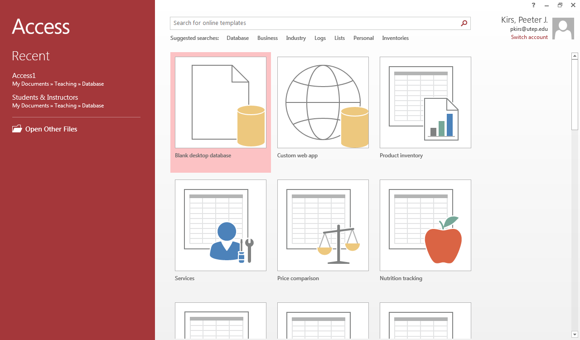
Joining Tables in Access
Open Access
Open a Blank Database

Slide 11
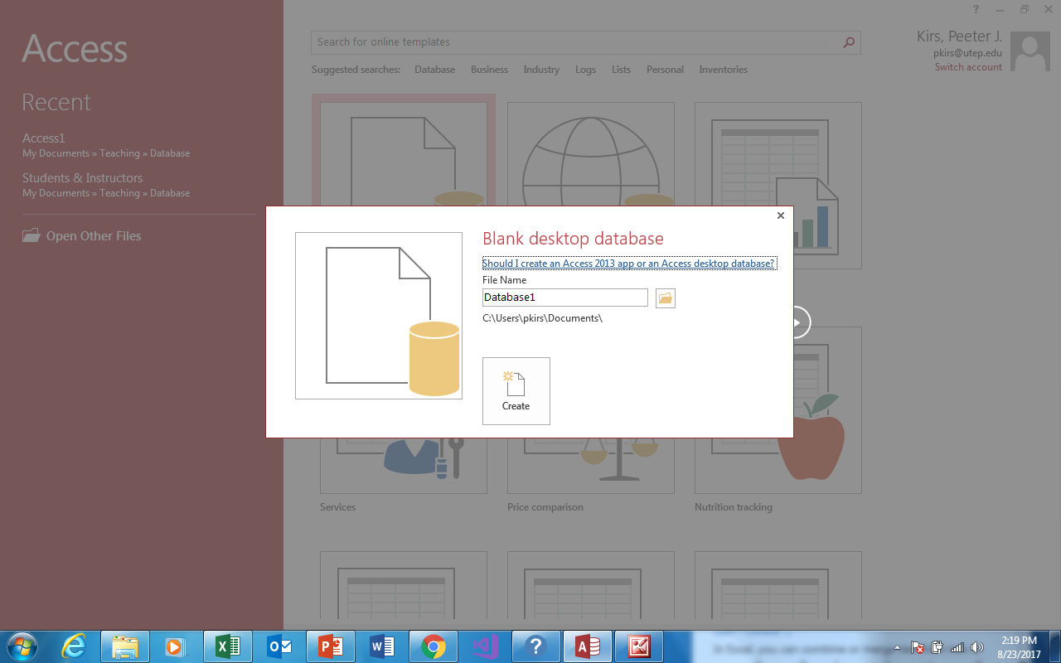
Joining Tables in Access
You will be asked to give your database a name

Slide 12
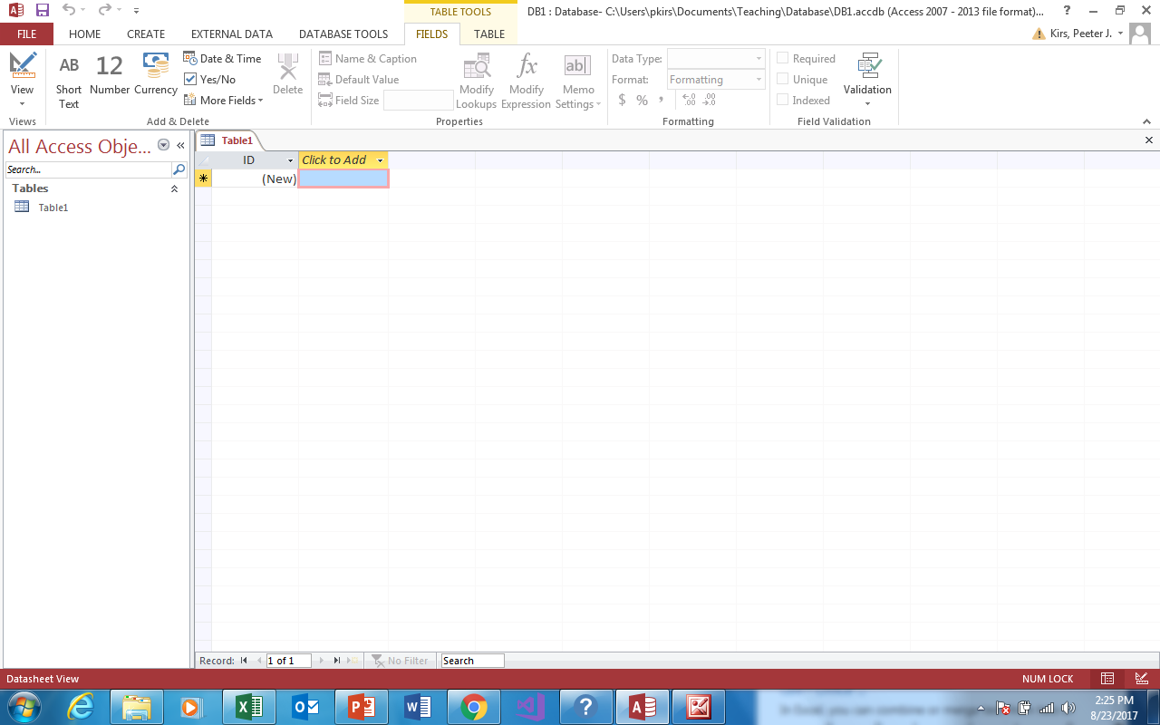
Joining Tables in Access
You can now start entering data
OR …
Also by default, Access creates a ‘primary key for you
By default, Access creates a table called ‘Table1’

Slide 13
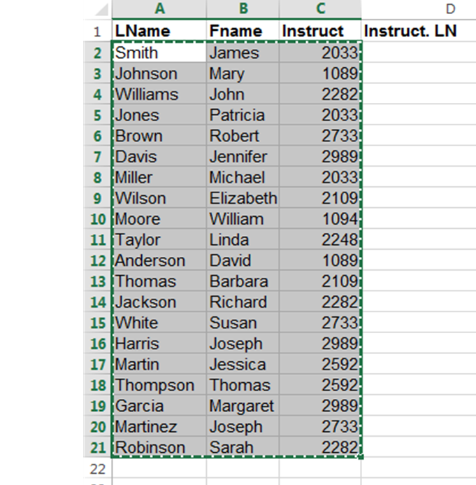
Joining Tables in Access
Since we already have the data stored in an Excel file, lets use that
Just copy the data (NOT the labels)

Slide 14
Joining Tables in Access
Go back to Access
Go to the Home Tab
Hit Paste

Slide 15
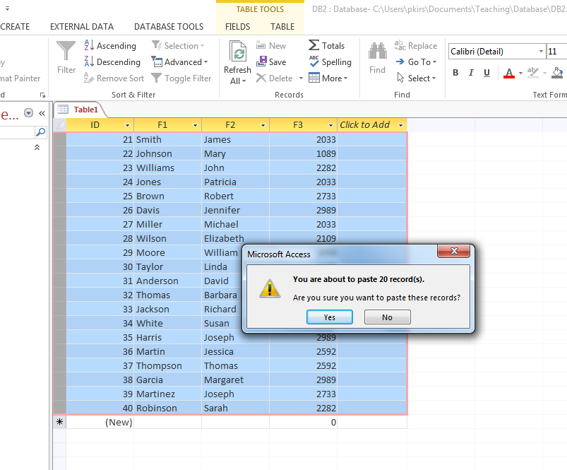
Joining Tables in Access
You should see:
Hit Yes

Slide 16
Joining Tables in Access
You can change the field name:
Click the Field
Right click, choose rename, and rename

Slide 17
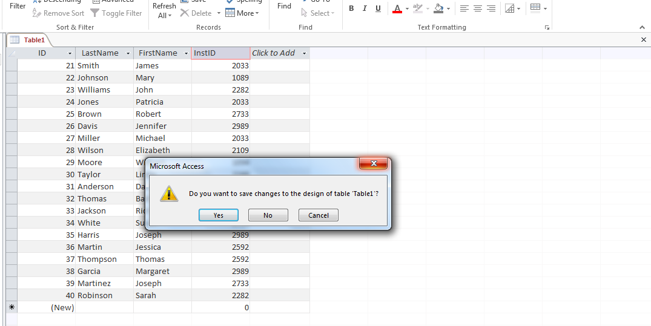
Joining Tables in Access
If you decide to close the Table
If you decide to close the Table
You will be asked if you want to save it

Slide 18
Joining Tables in Access
You will be asked if what table name to save it as (This is our student Table)

Slide 19
Joining Tables in Access
Notice the Table name has been changed
Go to create
And choose Table

Slide 20
Joining Tables in Access
Notice We’re back to where we started with our Student table
Follow the same steps we used to create table Students
Copy the Instructor data from the Excel spreadsheet and insert it into the table
Change the field names
Save the table as ‘Instructors’

Slide 21
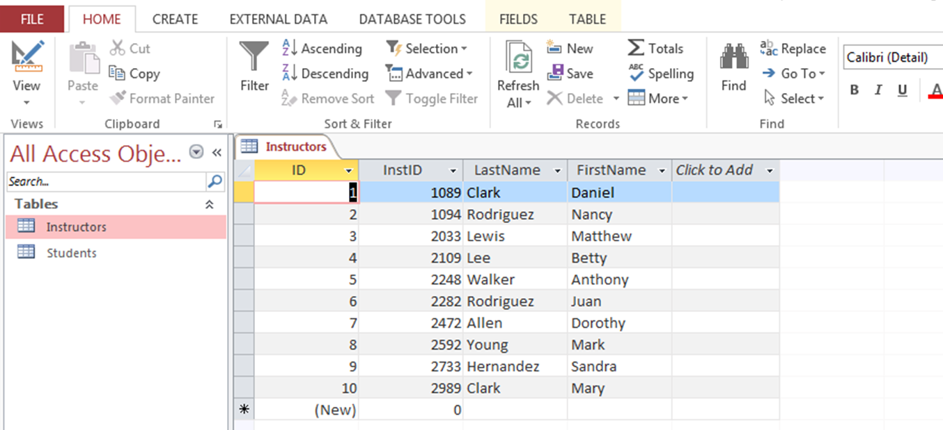
Joining Tables in Access
Let’s take a look at our Instructor Table

Slide 22
Joining Tables in Access
You can get here (datasheet view) by simply clicking on the table name
There is one problem with this table
As noted, Access automatically creates a field called ID which becomes the primary key
For our example, we want InstID to be the primary key so we can join the table to Students by linking it to field InstID in table Students

Slide 23
Joining Tables in Access

Slide 24
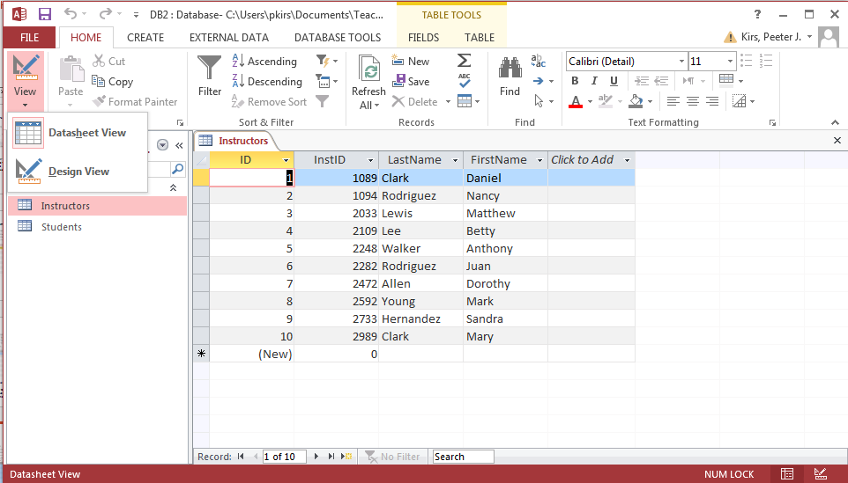
Joining Tables in Access
Click on the view option
And then on the design view

Slide 25
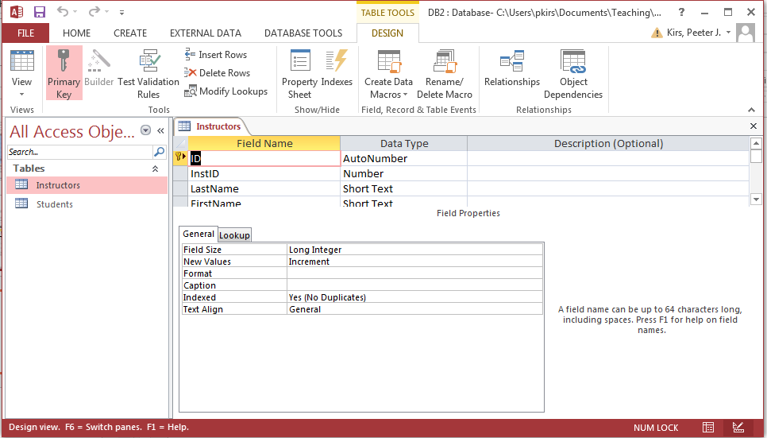
Joining Tables in Access
We can now delete the primary key
Click on the field name
The options list will appear
Choose Delete rows
Yes
Yes

Slide 26
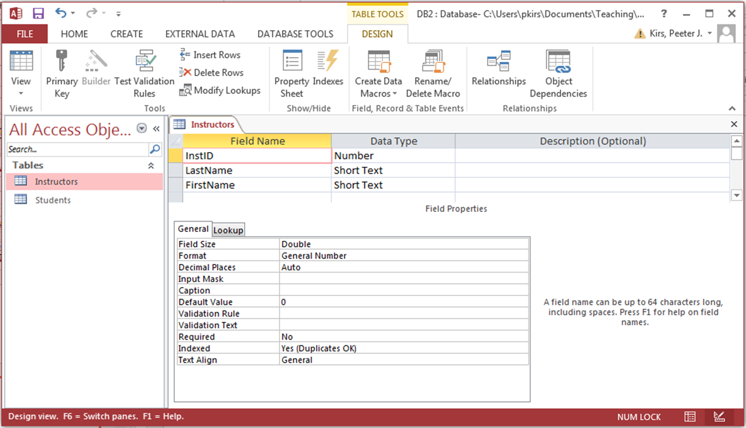
Notice ID is gone
Joining Tables in Access
Now let’s make InstID the primary key
Make sure the field is highlighted
Make the field the primary field by clicking the primary key icon

Slide 27
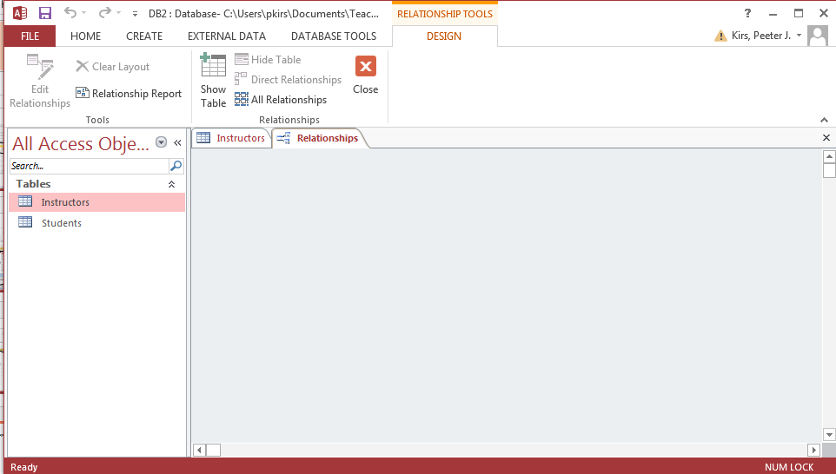
Joining Tables in Access
Let’s join the two tables together
Go to the DATABASE TOOL Tab

Slide 28
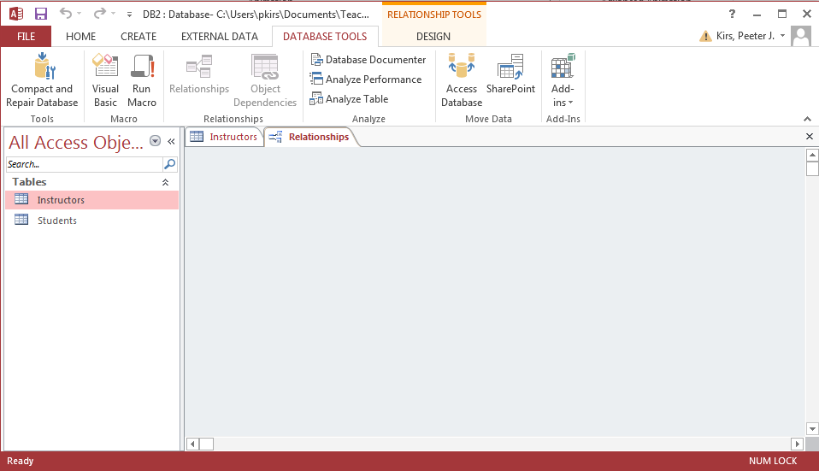
Joining Tables in Access
Click on Relationships Icon
A pop-up will ask you what tables you want to join
You can add one at time, or in our case, both

Slide 29
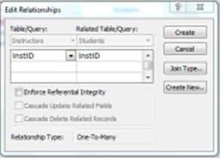
Joining Tables in Access
Use your mouse to indicate what fields in each table you want to join on
A pop-up will appear asking how you want to join the tables

Slide 30
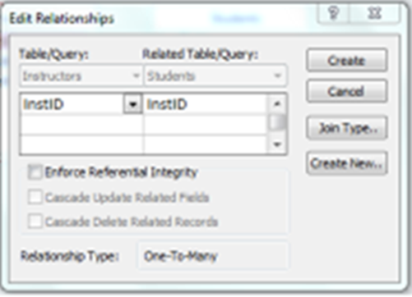
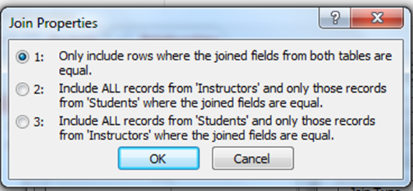
Joining Tables in Access
Let’s take a closer look at the pop-up
This would be the best choice

Slide 31
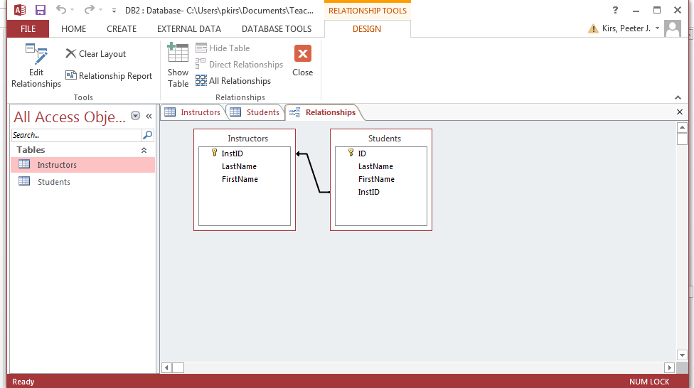
Joining Tables in Access
This is what your relationship should look like

Slide 32
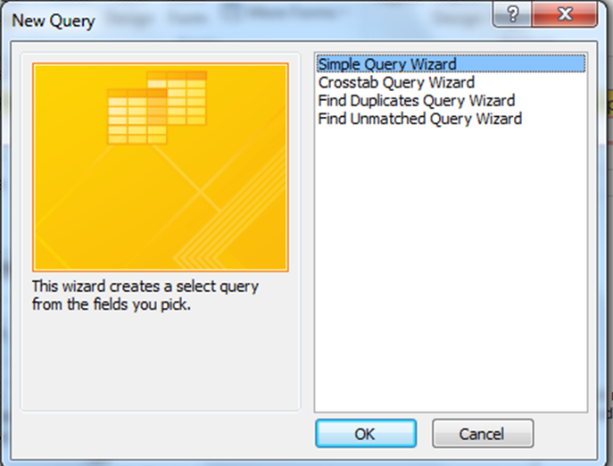
Queries in Access
To get output in access, we need to create a query
Let’s create one
Go to create tab
Now go to the Query Wizard Tab
A simple query is all we need

Slide 33
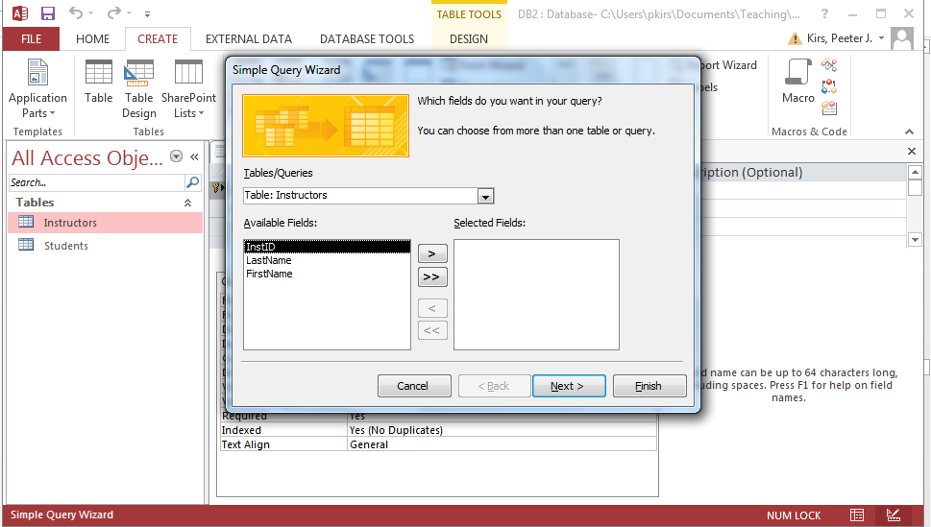
Queries in Access
Select the you want; I chose Lastname and Firstname
Then just move the field names to the selected field box

Slide 34
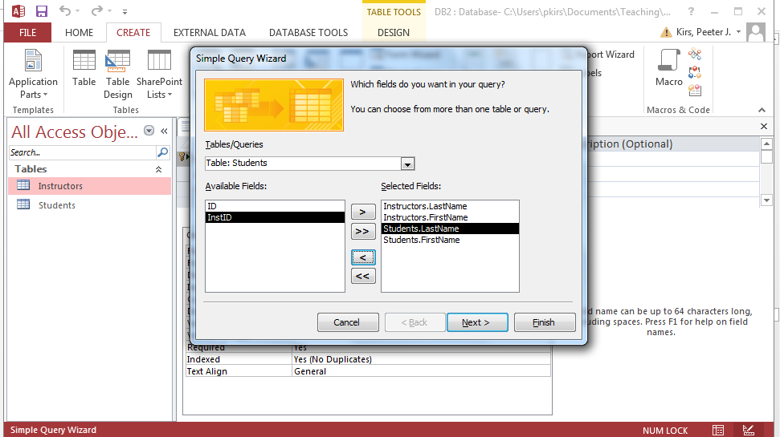
Queries in Access
WE HAVE A BIG PROBLEM !
We need to include ID and InstID
Notice I added lastnames and firstname for BOTH instructors and Students

Slide 35
Queries in Access
Now we can finish

Slide 36
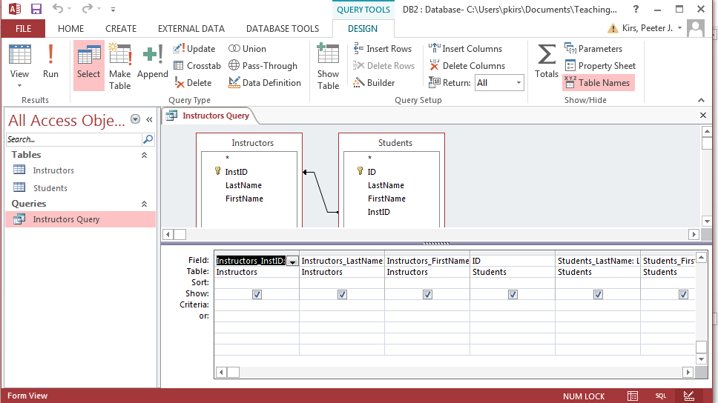
Queries in Access
We have created a QBE(Query by example)
We can modify it, but first let’s just look at the output
Click on the run tab

Slide 37
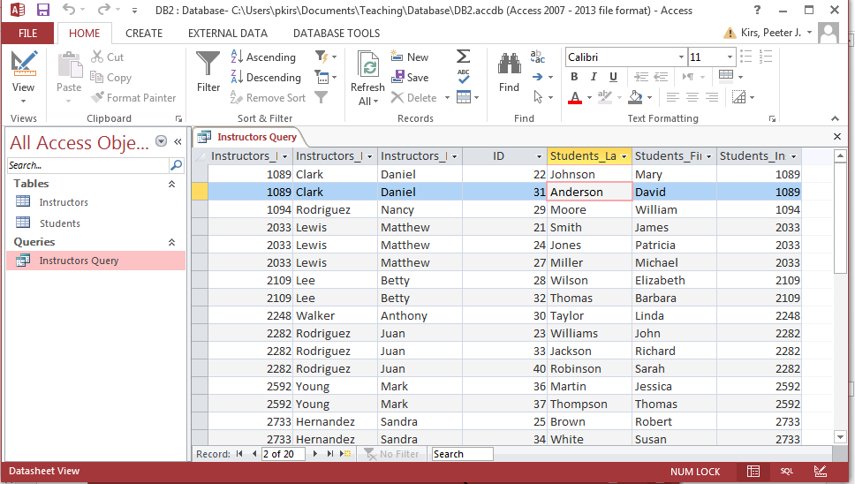
Queries in Access
We can modify it the output if we go to the Design View

Slide 38
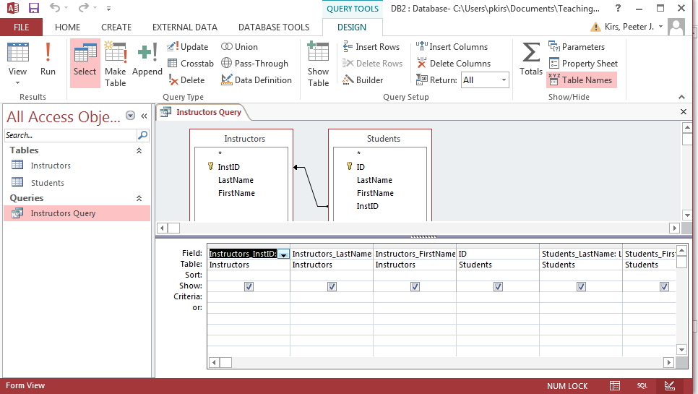
Queries in Access
OR we can look at the SQL commands we created (using QBE)

Slide 39
Queries in Access
SELECT Instructors.InstID AS Instructors_InstID, Instructors.LastName AS Instructors_LastName, Instructors.FirstName AS Instructors_FirstName, Students.ID, Students.LastName AS Students_LastName, Students.FirstName AS Students_FirstName, Students.InstID AS Students_InstID
FROM Instructors RIGHT JOIN Students ON Instructors.[InstID] = Students.[InstID];

