Slide 1
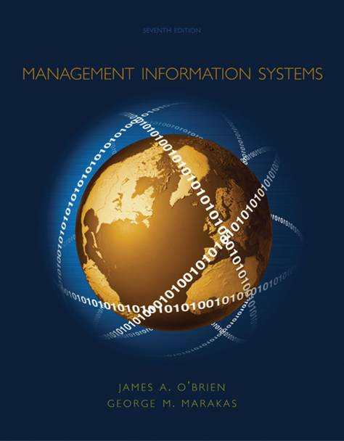
Well, Sort-of

Slide 2
What is a Computer??
All computers are systems of input, processing, output, storage, and control components.
A programmable machine. The two principal character- istics of a computer are (Webopedia):
It responds to a specific set of instructions in a well-defined manner.
It can execute a prerecorded list of instructions (a program).
Modern computers are electronic and digital. The actual machinery -- wires, transistors, and circuits -- is called hardware; the instructions and data are called software.

Slide 3
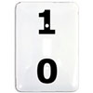
How does it work??
Basically, a computer is nothing more than a grouping of light switches
That’s Ridiculous!!!
No – that’s about all it is
Suppose that I wished to send you a message about whether we will have class today – or not.
Let’s assume that we come to an agreement:
If we are going to have class, I will leave the light-switch on
If we are NOT going to have class, I will leave the light-switch off
On
Off
(Class)
(No Class)

Slide 4
How does it work??
This is a binary situation
A light-switch can either be on or off
(A binary situation)
Data are processed and stored in a computer system through the presence or absence of electronic or magnetic signals in the computer’s circuitry or in the media it uses
But a light-switch??
Yes – They are actually micro-switches packed into integrated circuits which, for the sake of simplicity, we refer to as a:
Bit = Binary Digit = {0, 1}

Slide 5
How does it work??
But if it is binary, then I can only have two states!!!
True – but if I have more light switches, I have more possible combinations
Suppose you plan to meet your friend this afternoon, but your not sure if you can, and if you can, when you can
You agree on the following scheme:
Both off (00)
I can’t meet
Left off, Right on (01)
Meet at 1:00 PM
Left on, Right off (01)
Meet at 2:00 PM
Both on (11)
Meet at 3:00 PM

Slide 6
How does it work??
So every time I add a light-switch, I have 2 more states??
Actually, every time you add a light-switch, you double the number of possible combinations
With 3 light-switches, you have 8 combinations:
000 100
001 101
010 110
011 111
With 4 light-switches, you have 16 combinations:
0000 0100 1000 1100
0001 0101 1001 1101
0010 0110 1010 1110
0011 0111 1100 1111

Slide 7
How does it work??
The General formula is:
I = B^{n} where: I = The amount of Information (messages) available
B = The base we are working in (Decimal or Binary)
n = The number of digits (e.g., decimals, bits) we have
Applying the formula to both decimal and binary values:
10⁰ = 1 2⁰ = 1
10¹ = 10 2¹ = 2
10² = 100 2² = 4
10³ = 1,000 2³ = 8
10⁴ = 10,000 2⁴ = 16
10⁵ = 100,000 2⁵ = 32
10⁶ = 1,000,000 2⁶ = 64
10⁷ = 10,000,000 2⁷ = 128
10⁸ = 100,000,000 2⁸ = 256
10⁹ = 1,000,000,000 2⁹ = 512
10¹⁰ = 10,000,000,000 2¹⁰ = 1,024

Slide 8
How many bits do we need to group together??
The obvious answer should be “As many as possible”
If we could group, for example, 15 bits together, we could represent:
2¹⁵ = 32,768 characters
Which is a substantial number
Unfortunately, because of the costs involved (as we will see), the question became “What is the minimum number of bits that you need?”

Slide 9
How many bits do we need to group together??
Computer designers needed to represent:
The alphabet (upper & lower case) 52
The digits 10
Special characters (! + - * / ? % #) ≈ 25
Hidden characters (BS, Enter, EOF, EOT) ≈ 20
≈ 107
Which requires 7 bits (2⁷ = 128) since 6 bits (2⁶ = 64) is insufficient

Slide 10
But aren’t they grouped together as a Byte??
That is true:
1-Byte = 8-bits
A Byte is used to represent a character
A Byte is the basic addressable unit in RAM
Because of early technology problems, an extra bit was needed to help catch transmission errors
Stored in RAM:
Parity Bit
1
0
1
1
0
1
1
1
Error
Sent to CPU:
1
0
1
1
0
0
1
1

Slide 11
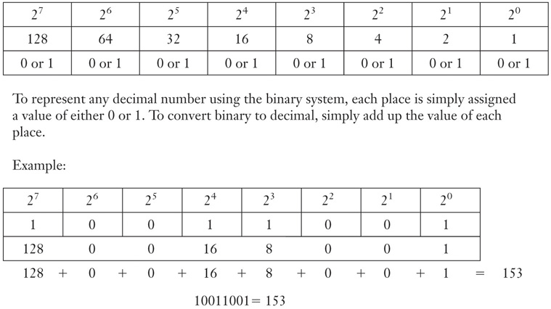
How do we do numerical operations in binary??
Any binary number can be represented using either a ‘0’ or a ‘1’
Click here for a Quick 5-Minute Tutorial on Converting and Adding in binary

Slide 12
What does this have to do with ASCII??
There was one problem with bytes: Compatibility
Given the binary sequences:
Manufact.
#1:
Manufact.
#2:
Manufact.
#3:
0000000
A
0
+
0000001
B
1
-
0000010
C
2
*
• • •
• • •
• • •
• • •
1111101
7
x
CR
1111110
8
y
LF
1111111
9
z
FF
Computer Manufacturers Interpreted the sequences differently

Slide 13
How does it work??
Which is the Correct Interpretation???
Each is equally Correct
0000010 Could be either a ‘C’ OR a ‘2’
The letter ‘C’ Could be pronounced either ‘cee’ OR ‘ess’
What’s the Solution ???
ASCII
The American Standard Code for Information Interchange
Click here for the Standard ASCII Table

Slide 14
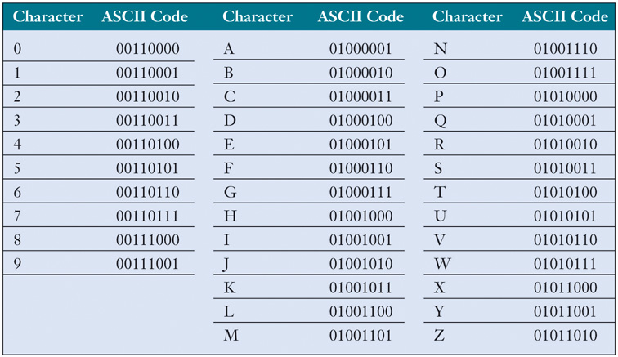
How does it work??
The ASCII character coding scheme:

Slide 15
Isn’t 128 OR EVEN 256 too few characters???
Yes – Enter Unicode (1990)
“A standard for representing characters as integers. Unlike ASCII, which uses 7 bits for each character, Unicode uses 16 bits, which means that it can represent more than 65,000 unique characters. This is a bit of overkill for English and Western-European languages, but it is necessary for some other languages, such as Greek, Chinese and Japanese. Many analysts believe that as the software industry becomes increasingly global, Unicode will eventually supplant ASCII as the standard character coding format”
Still considered a work in progress
The down-side of Unicode?
Double the amount of storage needed
New/Additional fonts needed
A political issue
See Unicode Consortium Members

Slide 16
How does it work??
What does this have to do with Kilobytes???
1 kilobyte (KB) = 1,000 bytes
(Actually, 1,024 bytes – Since 2¹⁰ = 1,024)
= 2¹⁰ * 8 = 1,024 * 8 = 8,224 bits
One page of typed text typically requires 2K
1 megabyte (MB) = 1M bytes
(Actually, 2²⁰ = 1,048,576)
= 2²⁰ * 8 = 1,048,576 * 8 = 8,388,608 bits
Storing the complete works of Shakespeare requires 5MB
1 gigabyte (GB) = 1B bytes
(Actually, 2³⁰ = 1,073,741,824)
= 2³⁰ * 8 = 1,073,741,824 * 8 = 9,448,9280,512 bits
A 2-hour film requires 1-2 GB
1 terabyte (TB) = 1 Trillion bytes
(Actually, 2⁴⁰ = 1,099,511,627,776)
= 2⁴⁰ * 8 = 1,099,511,627,776 * 8 = 8,796,093,022,208 bits
All of the books in the Library of Congress requires 15 TB

Slide 17
How does it work??
What does this have to do with Kilobytes???
1 Petabyte (PB) = 1 quadrillion bytes
(2⁵⁰ = 1,125,899,906,842,624 )
= 2⁵⁰ * 8 = 9,007,199,254,740,992 bits
Google processes about 1 PB every hour
1 Exabyte (EB) = 1 quintillion bytes
(2⁶⁰ = 1,152,921,504,606,846,976)
= 2⁶⁰ * 8 = 9,223,372,036,854,775,808 bits
Equivalent to 10 billion copies of the Economist*
1 Zettabyte (ZB) = 1 sextillion bytes
(2⁷⁰ = 1,180,591,620,717,411,303,424)
= 2⁷⁰ * 8 = 1,444,732,965,739,290,427,392 bits
The total amt. of information in existence is estimated at 1.2 ZB
1 Yottabyte (YB) = 1 septillion bytes
(2⁸⁰ = 1,208,925,819,614,629,174,706,176)
= 2⁸⁰ * 8 = You do the math
Presently unfathomable
* Excerpted from a Feb. 27th, 2010, Economist article

Slide 18
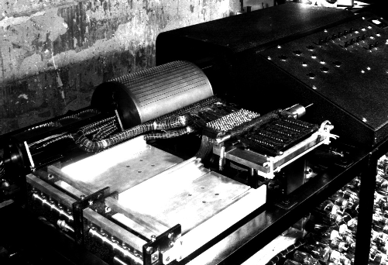
How did computers come about??
☑ 1939: Atanansoff & Berry (Iowa State)
☑ The ABC Machine
☑ Funded by Department of War
☑ 1944: Howard Aiken (Harvard University)
☑ The MARK I
☑ Also Funded by the Department of War
☑ VERY FAST:
3 Seconds/Multiplication !!!

Slide 19
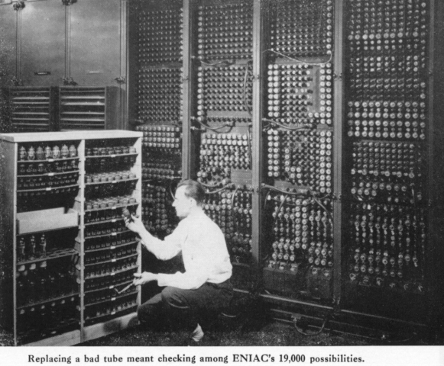
How did computers come about??
☑ ENIAC
Electronic Numerical
Integrator And
Calculator
☑ Large:
☑ 30 Tons
☑ 1,500 Square Feet
☑ 19,000 Vacuum Tubes
☑ When in Operation, Caused a ‘Brown-out’ in Philadelphia

Slide 20
??? So which was the 1st Real Computer ???
☑ The ABC Machine used electromagnetic relays, and was really more of a prototype
☑ The MARK I was fully functional, but also relied on Electromechanical Parts
☑ ENIAC had NO moving parts
??? So ENIAC was the 1st Real Computer ???
☑ The Issue was Contested
☑ In 1973, A federal Court awarded credit for the 1st computer to John Vincent Atanasoff and his assistant, Clifford Berry (The ABC Machine)
☑ Some still feel that ENIAC was the 1st Computer

Slide 21
??? Did the 1st Generation of computers begin with the ABC Machine or ENIAC ???
Neither
☑ Eckert & Mauchly (from U.P.) went on to form the Remington-Rand Corporation
☑ In 1951, Remington-Rand Produced (and sold) the 1st Commercially available Machine
☑ The UNIVAC I
??? So What ???
The 1st Generation of Computers Begins with the Sale of the UNIVAC

Slide 22
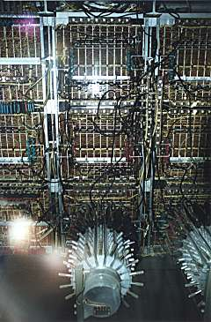
The 1st Generation of Computers (1951 - 58)
Onset:
Sale of the first UNIVersal Automatic Computer (UNIVAC)
An extension of the ENIAC
Cost:
$500K to $30M
Major Uses:
Government
The 1st machine was sold to the US Census Department
Military
Scientific Applications

Slide 23
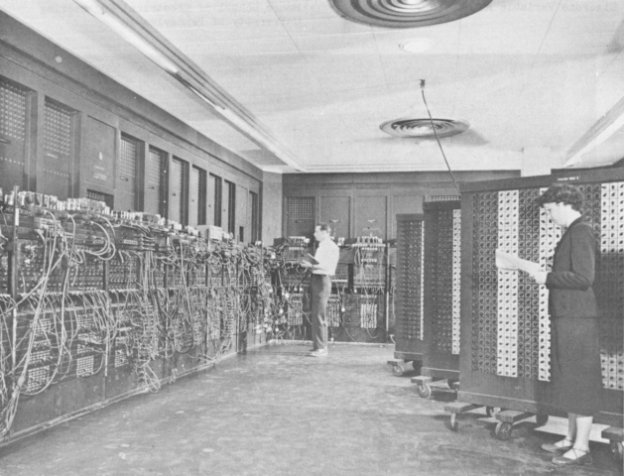
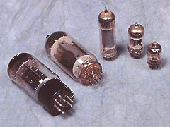
The 1st Generation of Computers (1951 - 58)
Technology:
Vacuum Tubes
Approx. 19,000 needed
Large
(Up to 6’ Tall)
Expensive
Fragile
Prone to Breakdowns and burn-outs
(Debugging)
Used An enormous amount of electricity
(200KW/H(?); Brownouts)
Gave off an enormous amount of heat
(AC Needed)

Slide 24
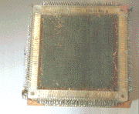
The 1st Generation of Computers (1951 - 58)
Speed:
2,000 – 3,000 Instructions per second
By 1999, Most PCs were running at about 9 MIPS
In 2000, A Germany company developed a computer running at 51 BIPS
Size:
The UNIVAC took up 1,500 square feet of space
IBM AN/FSQ-7 built for the US Air Force weighed 30 tons and took up as much space as a High School Gymnasium
Memory:
Originally: Drum Memory
Later: Magnetic Core (Donuts)
Magnetic Core
1,000 – 4,000 ‘donuts’ (125 – 500 Chars)
Average:

Slide 25
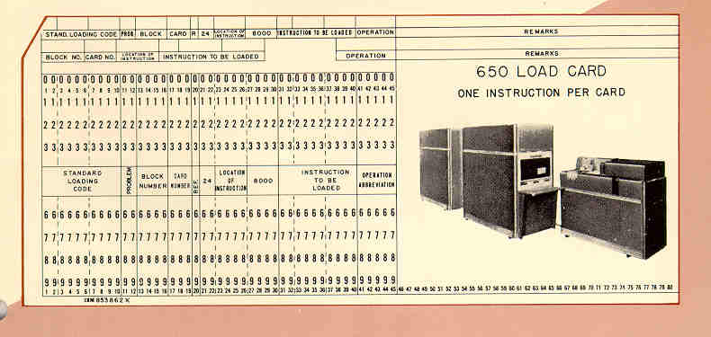
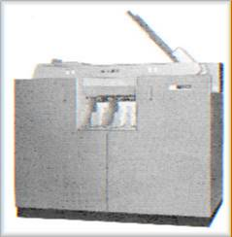
The 1st Generation of Computers (1951 - 58)
Secondary Storage:
Punched Cards
Dated Back to Herman Hollerith in 1880
Operating Environment:
Dedicated Machines
The programmer 1st got the operating system (on cards)
Then the (usually) FORTRAN/COBOL compiler (on cards)
They added their program (on cards)
Then fed the Deck into the card reader
+
Program
Operating System
+ compiler

Slide 26
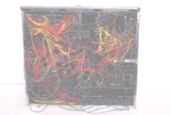
The 1st Generation of Computers (1951 - 58)
Program Languages:
Machine language (1st Generation)
Programmers needed to know all of the Operating Codes (in Binary), keep track of memory (in binary), and enter all code in binary
IBM Wiring Board
Cost:
$500,000 - $30M
(Approximately $4.19M to $251M in 2011 dollars)
Availability:
2,550
(1958)

Slide 27
The 1st Generation of Computers (1951 - 58)
A Typical Set-up: An IBM 650 in 1956:
($1.00 in 1956 = $8.32 in 2011)
The rental price for the CPU and power supply was $3,200/month
This was about the complete price of a fully loaded Cadillac
The equivalent of $26,624 in 2011
The CPU was 5ft by 3ft by 6ft and weighed 1966 lbs
The power unit was 5ft by 3ft by 6ft and weighed 2972 lbs
A shirt pocket HP-100 will run on 2 AA cells and is much faster
A card reader/punch weighed 1295 lbs and rented for $550/month ($4,576)
The probable operating ratio was 80% -- not guaranteed
The estimated cost of spare parts was $4000/year ($33,280 in 1998)
The 650 could add or subtract in 1.63 mill-seconds, multiply in 12.96 ms, and divide in 16.90 ms
The memory on most systems was magnetic drum with 2000 word capacity
For an additional $1,500/month you could add magnetic core memory of 60 words with access time of .096ms

Slide 28
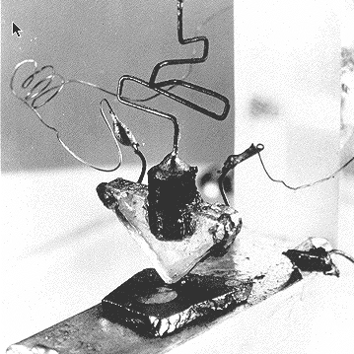
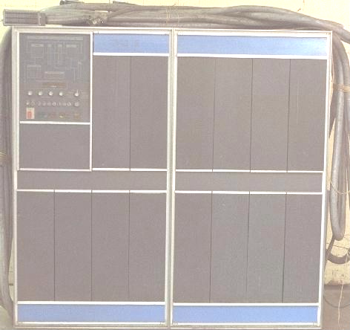
The 2nd Generation of Computers (1959 - 65)
Onset:
1948: Bell Labs
First Transistors
1954: TRADIC
800 Transistors
1959: IBM7000
No Vacuum Tubes
1959: IBM1401: A Success Story
IBM completely dominates the computer market
Uses:
Expanded Government and Research usage
The IBM-1407
Large Businesses
(Almost exclusively for Accounting)

Slide 29
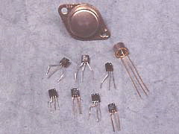
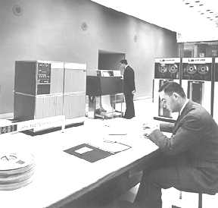
The 2nd Generation of Computers (1959 - 65)
Technology:
Transistors
Relatively Small
Much Cheaper
Required Less Electricity
Gave off less heat
Less prone to break-downs
Could be Mass Produced
The IBM-1407 System

Slide 30
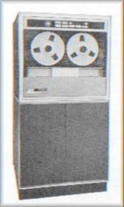
The 2nd Generation of Computers (1959 - 65)
Speed:
1 – 1.2 MIPS
Clock Speeds of about 0.086 mHz
(vs. about 2 gHz, or better, for most PCs today)
Memory:
All Magnetic Core
The IBM-1401 typically had between 4k to 16k (32k was considered large)
(In 2001, 1 MB of RAM could be purchased for as little as $0.19)
Secondary Storage:
Still mostly Punched Cards
Magnetic Tape Available
Used 2-10½ Reels
Capable of storing 14 MB/Reel
(The Equivalent of about 175,000 punch cards)
IBM Tape Reader

Slide 31
The 2nd Generation of Computers (1959 - 65)
Cost:
Variable:
Year
Model
Cost (in that year’s $)
1959
IBM 7090
$3,000,000
1960
IBM 1620
$200,000
1960
DEC PDP-1
$120,000
1960
DEC PDP-4
$65,000
1962
UNIVAC III
$700,000
1964
CDC 6600
$6,000,000
1965
IBM 1130
$50,000

Slide 32
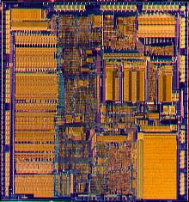
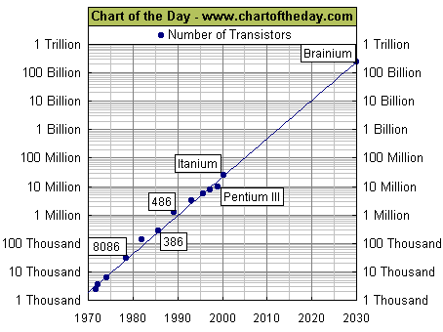
The 3rd Generation of Computers (1968 - 70)
Onset:
Photolithography
(Reduction and Burning)
Small Scale Integration
(SSI)
10’s of transistors/chip
Medium Scale Integration
(MSI)
100’s of transistors/chip
Large Scale Integration
(LSI)
1,000’s of transistors/chip
Very Large Scale Integration
(VLSI)
Millions of transistors/chip

Slide 33
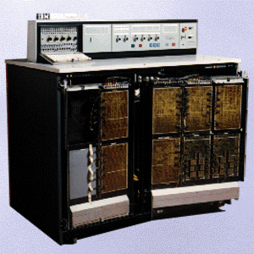
The 3rd Generation of Computers (1968 - 70)
Onset (Cont.):
IBM 360 series
Several Models Available
Expandable
Software Unbundling
Software Compatibility
(More Anti-trust legislation pending)
Uses:
Medium Size Businesses
Educational Facilities
Still primarily Accounting (TPS) but some Managerial Reporting

Slide 34
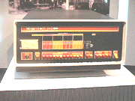
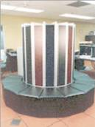
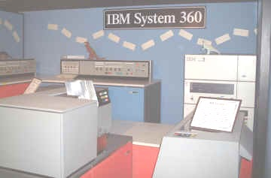
The 3rd Generation of Computers (1968 - 70)
Major Changes:
Market Segmentation
Smaller Businesses
Small Universities
Mini-Computers
(DEC PDP-1 Introduced in 1960)
DEC PDP-8
Large Research Ctrs.
Companies needing extra resources
Super Computers
(CDC Cyber 6000 Introduced in 1964)
Cray Y-MP (1988)
Mainstream Businesses and Organizations
Mainframes
(UNIVAC Updated)

Slide 35
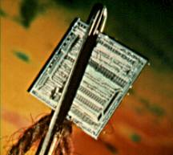
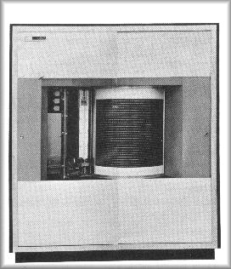
The 3rd Generation of Computers (1968 - 70)
Technology:
Integrated Circuits (ICs)
Small
Used little Electricity
Cheap
Gave off little heat
Durable
Seldom Broke down
Speed:
0.01 Microsecond per operations
(1,000,000/.01 = 100 MIPS)
Memory:
32K to 3MB
This integrated circuit, an F-100 microprocessor, is only 0.6 cm square and is small enough to pass through the eye of a needle.
Secondary Storage:
Magnetic Disks
(Up to about 3 GB)
(In 2001, a 120 GB Drive sold for as little as $275)
The IBM 1405 Disk:
Could store up to 10 MB per disk
Had up to 50 Disks, each 2’ in Diameter
Purchase price per MB: around $10,000
(vs. $0.002 for the drive above – 5,000,000 times cheaper)
IBM 1405 Disk Storage

Slide 36
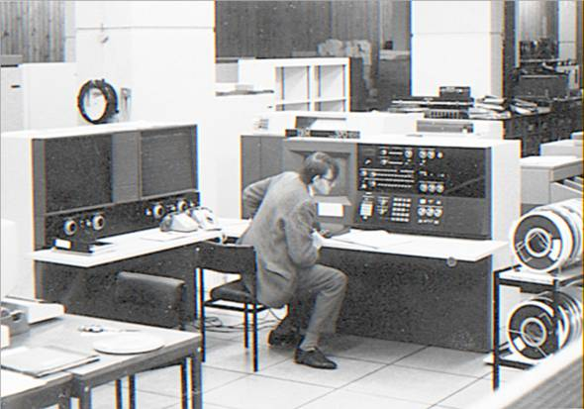
The Early 4th Generation of Computers (1970 - 81)
Onset:
The IBM 370 Introduced
LSI
Metal Oxide Semi-conductors (MOS) for memory
Evolutionary NOT Revolutionary
Why a new generation??
Because IBM said so!
Uses:
Almost All Businesses/Research Facilities
All Educational Facilities

Slide 37
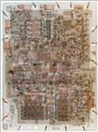
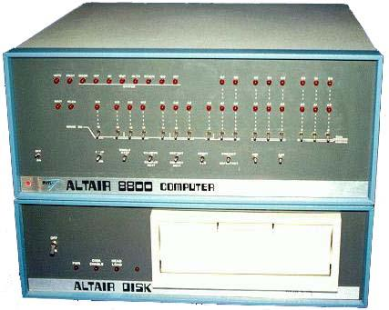
The Early 4th Generation of Computers (1970 - 81)
Other Developments:
1969: 1st Microprocessor developed at Intel
1974: Intel 4004 commercially available
1974: Edward Roberts develops the MITS Altair 8800.
Sold for $375
Intel 4004
Contained, a board set, CPU, front panel (without switches), four slot backplane and a 1K memory board with 256 bytes of RAM chips (not 256k).
There was no case, no power supply no keyboard, no display, and no auxiliary storage device.
(But Hacker’s Loved it)
Altair 8800
THE 4th GENERATION IS NOW OFFICIALLY UNDERWAY !!!

Slide 38
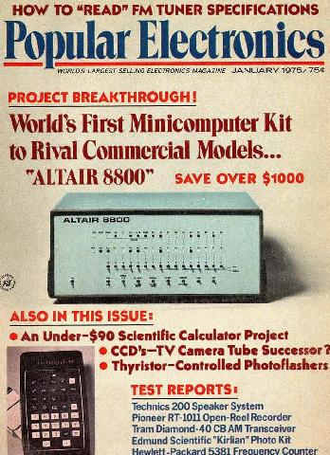
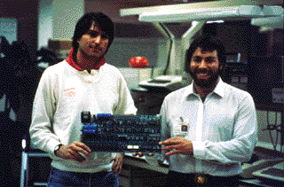
The Early 4th Generation of Computers (1970 - 81)
Other Developments (Cont):
1975: Popular Electronics Magazine publishes an article on how to build ‘A Personal Computer’
(Hacker’s go crazy!)
1975: The Homebrew Computer Club
Jobs meets Wozniak
Together they start producing computer boards (initially), then computers, in Jobs’ parent’s garage
The rest, as they say, is history
1977: Apple II Introduced
(1983 Sales: $983M)

Slide 39
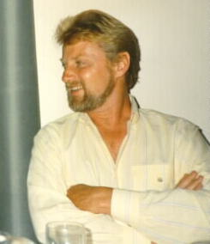
Middle 4th Generation of Computers (1981 - 87)
Developments:
IBM decides to use an ‘open-architecture’ approach
They would use the Intel 8080 (decided in 1980)
They would go shopping for an operating system
First Stop: Gary Kildall creator of the PL/M programming language for the Intel 8008 and developer of the CP/M (Control Program/Monitor) operating system
He wasn’t home
His wife refused to sign the ‘Non-Disclosure’ form (i.e., “We never talked to IBM, and even if we did, I can’t tell you what we said”) that IBM always required
Gary Kildall (1946–94)

Slide 40
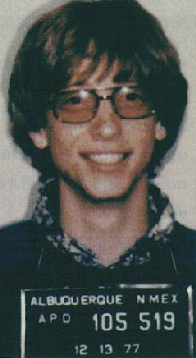
Middle 4th Generation of Computers (1981 - 87)
Developments (Cont):
Next Stop: Microsoft
Microsoft had developed BASIC interpreters, primarily for the Altair
Did they have an operating system for the PC?
“Of Course!”, Bill lied
So, how did they get the operating system?
Microsoft bought all rights to the 86-DOS from Seattle Computers System in 1928 for $50,000
MS-DOS version 1 operating system released in August, 1981. Used 160 Kb memory and a single sided floppy disk
Microsoft decides to license MS/DOS to IBM, while IBM ceded control of the license for all non-IBM PCs.

Slide 41
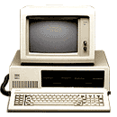
Middle 4th Generation of Computers (1981 - 87)
Developments (Cont):
The Result:
The IBM PC Released in 1981
Intel 8080 CPU operating at 4.77 mHz
64K Ram
1 5¼” Floppy Drive (No Hard Drive)
B/W (Green, really) Monitor
Approximate cost: $5,000
65,000 units sold by end of the year.
23% Market Share by 1983
Bill Gates?
Forbes Magazine credits him with a net worth of $66 Billion as of September 2012 (at which point he had given away $28 billion). At that time he was ranked the 2nd richest man in the world, and the richest in the US

Slide 42
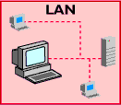
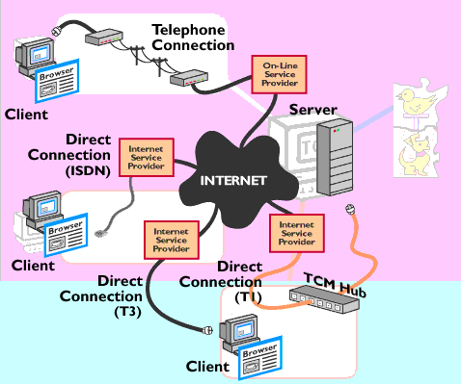
The Later 4th Generation of Computers (1987 - )
Major Advances:
LANs
Intranets
Internet
ARPANET (1969)
WWW (1992)
Extranets
Focus:
Intra-Organizational
Inter-Organizational
Global Positioning
Business Effectiveness

Slide 43
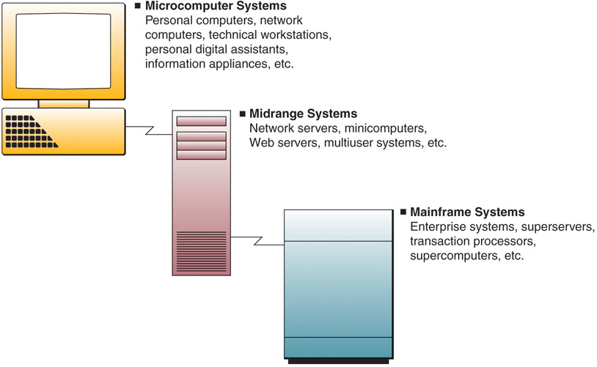
Where are we now??
Types of Computer Systems
Primarily high-end network servers and other types of servers that can handle the large-scale processing of many business applications.
Large, fast, and powerful computer systems

Slide 44
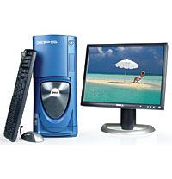
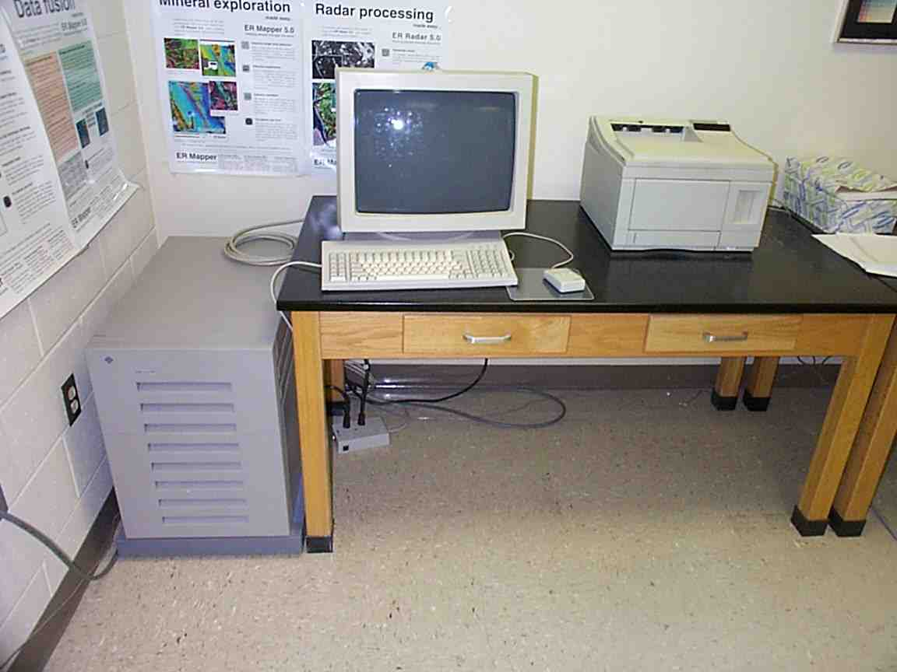

Where are we now??
Microcomputer Systems
Dell XPS Desktop System
Sun Workstation for Image Analysis
Computer (PC): microcomputer for use by an individual
Laptop:
small, portable PC
Workstation:
a powerful, net-worked PC for business profes-sionals

Slide 45
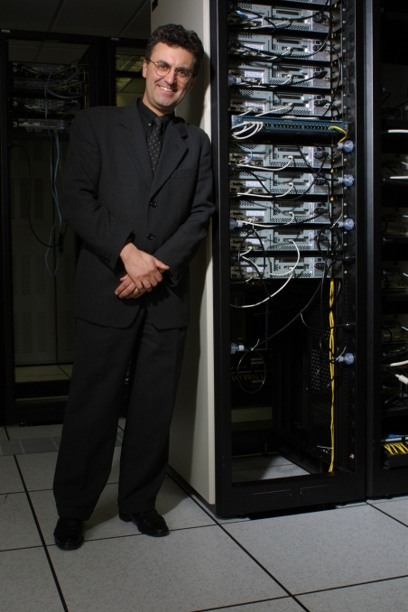
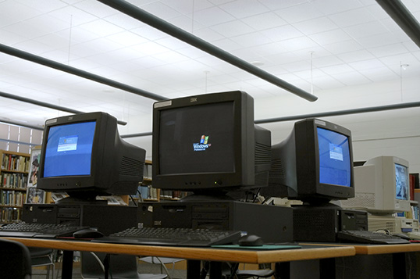
Where are we now??
Microcomputer Systems
Network Server: more powerful microcomputers that coordinate telecommunicationsand resource sharing in small local area networks and Internet and intranet websites
Computer Terminals:
depend on servers for software, storage and processing power

Slide 46
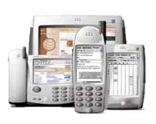
Where are we now??
Microcomputer Systems
Network Terminals:
Information Appliances:
This is the same Picture !!!
hand-held microcomputer devices
The difference is that these computers have no or minimal disk storage

Slide 47
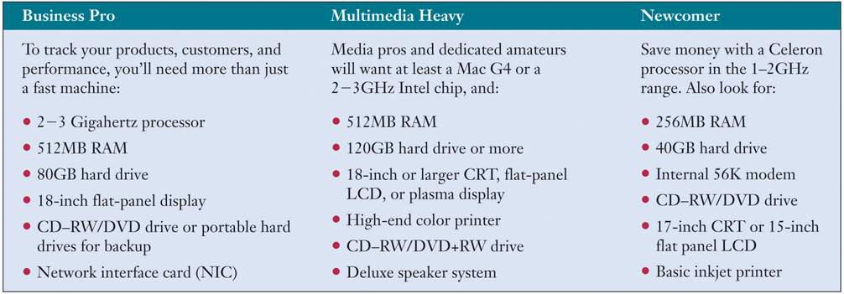
Where are we now??
Typical PC Features
OK - But where are we now??

Slide 48

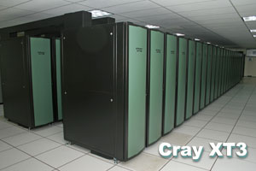
Where are we now??
There are also:
uper Computers !!!
Extremely powerful computer systems specifically designed for scientific, engineering, and business applications requiring extremely high speeds for massive numeric computations
Up to 4,176 processors
Capability: up to 26 trillion floating point calculations a second
(it would take 1000 scientists almost 350 years of working around the clock to do the same number of computations the Cray XT3 can do in a single second)
Cost: $200 Million

Slide 49
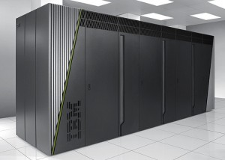
Where are we now??
There are also:
uper Computers !!!
Update (2012): IBM’s Sequoia supercomputer
1,572,864 CPU cores
16.32 petaflop/s
(55% faster than the 2011 fastest super computer)
The machine can process in one hour what it would take 6.7 billion people (slightly less than every person on the planet) 320 years to calculate using calculators.

Slide 50
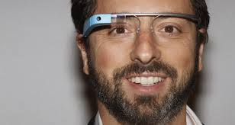
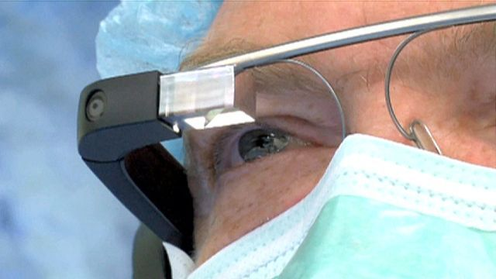
Where are we going??
Google Glass
On Aug. 21, 2013, Dr. Christopher Kaeding, director of sports medicine at Ohio State University Wexner Medical Center, wore Google Glass as he performed surgery on the anterior cruciate ligament (ACL) in the knee of a 47-year-old woman.
The procedure was livestreamed to a group of medical students, who watched on laptops, and to Dr. Robert Magnussen, an assistant professor of clinical orthopedics at Ohio State, who watched from his office.
Read more: http://www.foxnews.com/science/2013/08/28/google-glass-to-livestream-surgery/#ixzz2e2eS3lkc

Slide 51
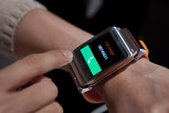
Where are we now??
Samsung’s Galaxy Gear (Sep 5, 2013)
1.63-inch (4.1-centimeter) screen
1.9-megapixel camera
syncs with tablets and smartphones using Google Inc.’s Android software to make phone calls.
$299

Slide 52
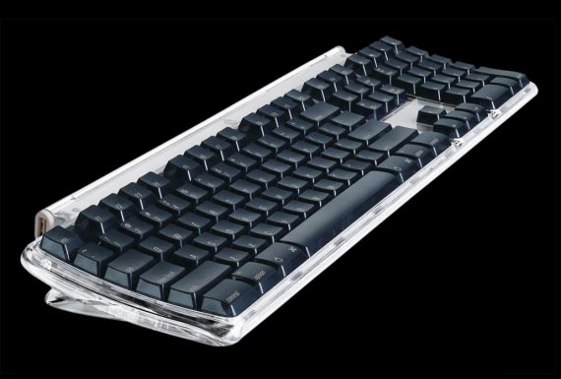
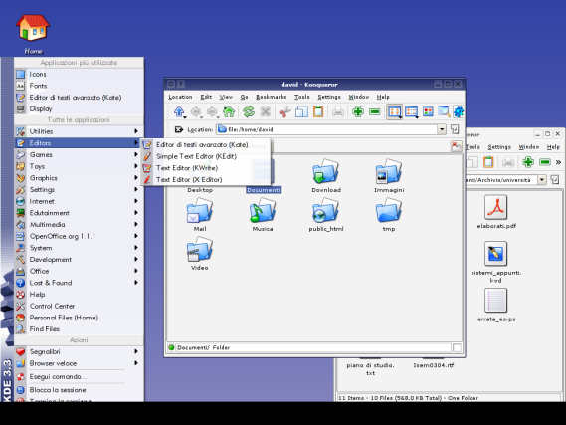
Hardware organized by function
Input Devices:
Hardware that converts data into electronic form for direct entry or through a telecommunications network into a computer system
Keyboard
(Not common until the Late 1970s, early 1980s)
Graphical User Interfaces
(GUIs)
Icons, menus, windows, buttons, bars, etc used for user selection

Slide 53



Hardware organized by function
Input Devices:
Pointing Devices
Electronic Mouse
Moving mouse on pad moves cursor on screen. Pressing buttons on mouse activates activities represented by selected icons.
Trackball
Stationary device with a roller ball on top used to move cursor on screen.
Pointing Stick
Small button-like device which moves cursor in direction of pressure placed on stick.

Slide 54




Hardware organized by function
Input Devices:
Pointing Devices
Pointing Stick
Pen-sized pointing sticks are used to "click" on the screen. It has a small tip so you can use it precisely
Touchpad
Small rectangular touch-sensitive surface which moves the cursor in the direction of finger moves on the pad.
Touch Screen
Video display screen that emits a grid of infrared beams, sound waves, or a slight electric current that is broken when the screen is touched.

Slide 55

Hardware organized by function
Input Devices:
Pen-based computing
Pressure-sensitive layer under slate-like liquid crystal display screen and software that digitizes hand-writing, hand printing, and hand drawing

Slide 56

Hardware organized by function
Input Devices:
Speech Recognition
Discrete
User must pause between each spoken word
Continuous
Software can recognize conversationally-paced speech

Slide 57


Hardware organized by function
Input Devices:
Optical Scanning
Devices that read text or graphics and convert them into digital input for your computer
Optical Character Recognition (OCR)
The machine identification of printed characters through the use of light-sensitive devices

Slide 58



Hardware organized by function
Input Devices:
Magnetic Stripe
devices that read data stored in the magnetic stripe on the back of cards
Smart Cards
devices that read a microprocessor chip embedded in a card
Point of Sale (POS)
devices that read a bar codes

Slide 59


Hardware organized by function
Input Devices:
Digital Cameras
devices that allow you to capture, store, and download still photos and full motion pictures
Magnetic Ink Recognition (MICR)
devices that can read characters printed on source documents with an iron oxide-based ink

Slide 60
Hardware organized by function
Processing Components:
Throughput (Conceived of by Babbage in 1822)
Ability of a microprocessor to perform useful computation or data processing assignments during a given period of time
Dependent upon:
CPU (Registers, Clock speed)
Buses – the size of circuitry paths that interconnect microprocessor components
Cache – high-speed memory
Specialized Processors

Slide 61

Hardware organized by function
Processing Components:
Central Processing Unit (CPU)
The component in a digital computer that interprets computer program instructions and processes data

Slide 62
Hardware organized by function
Processing Components:
Central Processing Unit (CPU)
Control Unit
Contains circuitry that uses electrical signals to direct the entire computer system to carry out, or execute, stored program instructions.
Like an orchestra leader, the control unit does not execute program instructions; rather, it directs other parts of the system to do so.
The control unit must communicate with both the arithmetic/logic unit and memory.

Slide 63
Hardware organized by function
Processing Components:
Central Processing Unit (CPU)
Arithmetic Logic Unit (ALU)
The arithmetic/logic unit (ALU) contains the electronic circuitry that executes all arithmetic and logical operations
The arithmetic/logic unit can perform four kinds of arithmetic operations, or mathematical calculations: addition, subtraction, multiplication, and division.
As its name implies, the arithmetic/logic unit also performs logical operations. (A logical operation is usually a comparison).

Slide 64
Hardware organized by function
Processing Components:
Central Processing Unit (CPU)
Internal Storage (Registers)
Registers are temporary storage areas for instructions or data. They are not a part of memory; rather they are special additional storage locations that offer the advantage of speed.
Registers work under the direction of the control unit to accept, hold, and transfer instructions or data and perform arithmetic or logical comparisons at high speed.
The control unit uses a data storage register the way a store owner uses a cash register-as a temporary, convenient place to store what is used in transactions.

Slide 65

Hardware organized by function
Processing Components:
Central Processing Unit (CPU)
Potential Improvements to the CPU???
SoC, or system-on-a-chip to give its full name, integrates the CPU, GPU (a graphics processor), memory, USB controller, power management circuits, and wireless radios (WiFi, 3G, 4G LTE, and so on). Whereas a CPU cannot function without dozens of other chips, it’s possible to build complete computers with just a single SoC.
A SoC is only a little bit larger than a CPU, and yet it contains a lot more functionality. If you use a CPU, it’s very hard to make a computer that’s smaller than 10cm (4 inches) squared, purely because of the number of individual chips that you need to squeeze in. Using SoCs, we can put complete computers in smartphones and tablets, and still have plenty of space for batteries..
Due to its very high level of integration and much shorter wiring, an SoC also uses considerably less power — again, this is a big bonus when it comes to mobile computing.
From: http://www.extremetech.com/computing/126235-soc-vs-cpu-the-battle-for-the-future-of-computing

Slide 66
Hardware organized by function
Processing Components:
How quickly does the CPU process data???
Clock Speed:
the speed at which a microprocessor executes instructions
1 Millisecond = 1 thousandth of a second
1 Microsecond = 1 millionth of a second
1 Nanosecond = 1 billionth of a second
1 Picosecond = 1 trillionth of a second
If the average could take 1 step every picosecond, they would circle the earth 20,000 times ---
EVERY SECOND!!

Slide 67

Hardware organized by function
Processing Components:
Semiconductor Memory (RAM):
Primary Storage
All data sent to the CPU must come from RAM
Fast
Shock, temperature resistant
Volatile – contents are lost when power is interrupted
(Trend toward non-volatile)
"random" (direct might be a better word) because any piece of data can be accessed and returned quickly, regardless of its physical location and whether or not it is related to the previous piece of data.

Slide 68
Hardware organized by function
Processing Components:
How quickly does the CPU process data???
Other measures:
Millions of Instructions per second (MIPS)
Gigaflops/Teraflops
(Billions/Trillions of Floating Point Operations Per Second)
Hertz = Number of cycles/second
Kilohertz = Thousands of cycles/second
Megahertz = Millions of cycles/second
Gigahertz = Billions of cycles/second

Slide 69



Hardware organized by function
Output Devices:
Impact Printers
Dot Matrix
Daisy Wheel
Line Printer
Page Printer
Inkjet Printers
spray ink onto the page

Slide 70

Hardware organized by function
Output Devices:
Laser Printers
use an electrostatic process similar to a photocopying machine

Slide 71


Hardware organized by function
Output Devices:
Video
Cathode Ray Tubes (CRT)
similar to vacuum tubes in television
Liquid Crystal Display (LCD)
electronic visual displays that form characters by applying an electrical charge to selected silicon crystals

Slide 72

Hardware organized by function
Output Devices:
Video
Light Emitting Diodes (LED)
Solid light bulbs that are extremely energy-efficient
Full HD TVs are typically 1080 horizontal lines of vertical resolution
Refresh rates typically 60 – 240 Hz

Slide 73
Hardware organized by function
3-D Printers
“The first industrial revolution began in Britain in the late 18th century with the mechanisation of the textile industry. In the following decades the use of machines to make things, instead of crafting them by hand, spread around the world. The second industrial revolution began in America in the early 20th century with the assembly line, which ushered in the era of mass production.
As manufacturing goes digital, a third great change is now gathering pace. It will allow things to be made economically in much smaller numbers, more flexibly and with a much lower input of labour, thanks to new materials, completely new processes such as 3D printing, easy-to-use robots and new collaborative manufacturing services available online. The wheel is almost coming full circle, turning away from mass manufacturing and towards much more individualised production. And that in turn could bring some of the jobs back to rich countries that long ago lost them to the emerging world.”
From: The Economist, Apr 21st 2012

Slide 74

Hardware organized by function
3-D Printers
Subtractive manufacturing
Material is removed from a larger object to make a smaller Object
Problems
Wasteful
Requires manual labor (generally)
Product Defects
Can work with one type material at a time
Expensive

Slide 75

Hardware organized by function
3-D Printers
Additive manufacturing
The object is built by adding one layer at a time
Advantages
Efficient
Customizable
Less Labor Intensive
Stronger
Can work with many types of materials at a time
Cheaper (at least soon; and productive efficiency is expected to increase exponentially over time)
Green IT

Slide 76



Hardware organized by function
3-D Printers
Future??
3-D printing, expected to reach $3.1 billion worldwide by 2016 and $5.2 billion by 2020 (Forbes, 3/27/2012) .
Increased applications; larger, more complex, lighter, cheaper
Bio-printing has been applied to build three-dimensional tissues and organ structures of specific architecture and functionality for purposes of regenerative medicine.
A 1 lb. reduction in weight reduces fuel costs by $50,000 over an airplane’s life
EADS hopes to increase scales and to “print” full aircraft wings.
The entire body of the Urbee was made with a 3D printer

Slide 77
Hardware organized by function
3-D Printers
This ‘Industrial Revolution’ will be different
The first two revolutions created jobs
3-D printers reduce the number of employees required
GKN Aerospace (England) only partially uses 3-D printers
In the 1980’s the firm employed 69,000 in Britain alone*
Today it employs 44,000 worldwide, with only 5,800 in Britain
But …
The wing produced for the AirBus is 27M (88.6 feet) long and are accurate to within 0.3mm (0.012 inches)
They are made solely of carbon-fiber composites, as strong as steel but much lighter
They are 40% more fuel efficient than conventional materials
From: The Economist, June 9th 2012

Slide 78
Hardware organized by function
Computer Peripherals:
The Generic name given to all input, output, and secondary storage devices that are part of a computer system, but are not part of the CPU.
Basic Classes:
Online
devices are separate from but can be electronically connected to and controlled by a CPU
Offline
devices are separate from and not under the control of the CPU

Slide 79

Hardware organized by function
Computer Peripherals:

Slide 80

Hardware organized by function
Magnetic Disks:
Secondary Storage
Fast
Reasonably Priced
Large
Direct Access vs. Sequential Access
What’s the difference???
Sequential Access
Data are recorded one after another in a predetermined sequence. Locating an individual item of data requires searching the recorded data until the desired item is located.
(think of an audio tape)

Slide 81



Hardware organized by function
Magnetic Disks:
Hard Disk Drives
access arms and read/write heads in a sealed module
Redundant Arrays of Independent Disks (RAID)
disk arrays of interconnected microcomputer hard disk drives
Floppy Disks
single disk inside a protective jacket

Slide 82


Hardware organized by function
Other Secondary Storage Devices:
Zip Drives (1994 – 2002??)
Originally 100MB, later up to 750 MB
Flash Drives
Flash memory (non-volatile) with an integrated Universal Serial Bus (USB) interface
Up to 256 GB (Sept. 2011)
‘Cloud’ Storage

Slide 83

Hardware organized by function
Optical Disks:
Compact Disc Read-Only Memory (CD-ROM)
Low-cost approach to saving data, loading programs, or listening to music
Firmware: Frequently used programs which are permanently burned into ROM during manufacture
Compact Disc Read-Write (CD-RW)
Allows Data to be written and rewritten (limited Times)

Slide 84
Hardware organized by function
Optical Disks:
Compact Disc Read-Write Digital Versatile Disc (CD-RW/DVD)
Allows reading of DVD-ROM, reading of CD-ROM and customization of CDs
Digital Versatile Disc Read-Only Memory (CVD-ROM)
Allows Data to be written and rewritten (limited Times)

Slide 85
Hardware organized by function
Optical Disks:
Digital Versatile Disc Read only Memory (DVD-ROM)
Allows Clear color, picture and sound clarity of DVD video on a PC
Preparation of software and large data files
Preparation of software and large data filesCan also read CD-ROM disks
DVD+RW/+R with CD-RW
All-in-one Drive
Burn DVD-RW or DVD-R, CD, read DVD and CDs
Archive up to 4.6GB of data
(7 times the capacity of a standard 650MB CD)

Slide 86



Hardware organized by function
Business applications of optical disks:
Long-term archival storage of historical files of document images
Publishing medium for fast access to reference materials in a convenient compact form
Computer video games, educational videos, multimedia encyclopedias and advertising presentations

Slide 87

Storage Trade-offs

Slide 88

The ‘Cloud’
A style of computing in which dynamically scalable and often virtualized resources are provided as a service over the Internet. Users need not have knowledge of, expertise in, or control over the technology infrastructure in the "cloud" that supports them. (definition from WIKIPEDIA)
For a good article see: http://www.sis.pitt.edu/~gray/LIS2600/references/MS_cloudComputing.htm

Slide 89


